Slide 1
Qemu Libvirt & KVM
popsuper

Slide 2
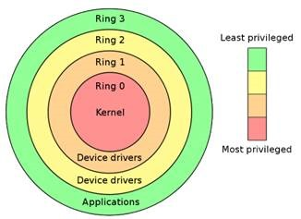
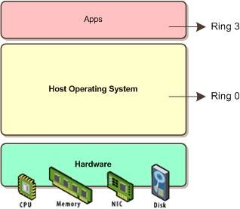
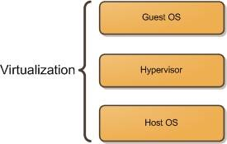
1.1 虚拟化的基本类型
无虚拟化
CPU一般设为四个Ring
Kernel Mode一般跑在Ring 0上
User Mode一般跑在Ring 3上
对于一个普通的传统的Linux系统没有问题
虚拟化
在Guest机器和Host机器中间加一层Hypervisor
Host机器看它像跑在自己上面的程序
Guest机器看它像自己所运行的硬件
如果Host机器和Guest机器都跑相同的Linux，它们的Kernel都想运行在Ring 0，可怎么办？

Slide 3
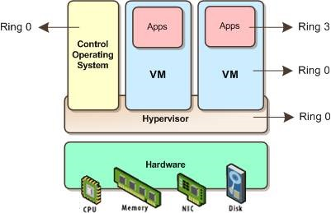
1.1 虚拟化的基本类型
半虚拟化Paravirtualization
Hypervisor运行在Kernel Mode, Ring 0
Guest OS不能直接运行在Ring 0，而是需要对Kernel进行修改，将运行在Ring 0上的指令转为调用Hypervisor
Guest OS上的APP运行在Ring 3

Slide 4
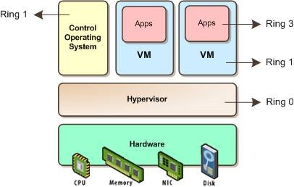
1.1 虚拟化的基本类型
非硬件辅助全虚拟化
Full Virtualization without Hardware Assist
Hypervisor运行在Ring 0
Hypervisor对Guest OS提供CPU模拟，由Hypervisor模拟一个CPU给VM，VM不直接使用真实的CPU
Guest OS不做修改，还是试图运行在Ring 0上，只不过是模拟CPU的Ring 0
Hypervisor对Guest OS的Ring 0上的指令进行转译，变成真实CPU的指令，只能运行在Ring 1上

Slide 5
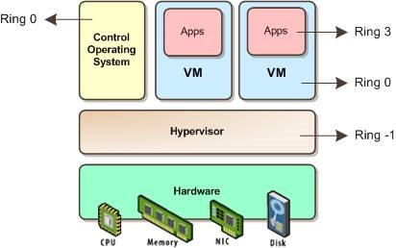
1.1 虚拟化的基本类型
硬件辅助全虚拟化
Full Virtualization with Hardware Assist
Intel VT and AMD-V创建一个新的Ring -1单独给Hypervisor使用
Guest OS可以直接使用Ring 0而无需修改

Slide 6
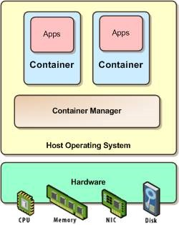
1.1 虚拟化的基本类型
OS virtualization

Slide 7
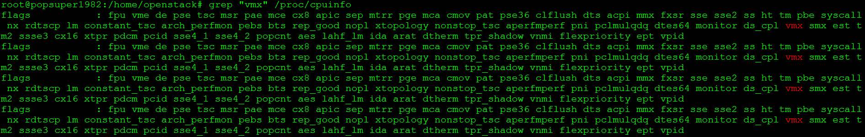
实验一：查看系统是否支持硬件辅助虚拟化
对于Intel CPU
对于AMD CPU
grep "vmx" /proc/cpuinfo
grep "svm" /proc/cpuinfo

Slide 8
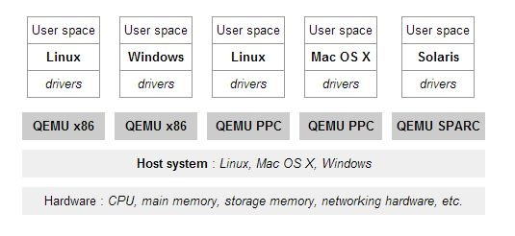
1.2 KVM Qemu Libvirt之间的关系
Qemu是一个模拟器，它向Guest OS模拟CPU，也模拟其他的硬件
正如非硬件辅助全虚拟化讲到的，Guest OS认为自己和硬件直接打交道，其实是同Qemu模拟出来的硬件打交道，Qemu将这些指令转译给真正的硬件。
由于所有的指令都要从Qemu里面过一手，因而性能比较差

Slide 9
1.2 KVM Qemu Libvirt之间的关系
KVM是内核的模块，采用硬件辅助虚拟化技术Intel-VT，AMD-V
使用KVM，Guest OS的CPU指令不用经过Qemu转译，直接运行，大大提高了速度
KVM通过/dev/kvm暴露接口，用户态程序可以通过ioctl来访问这个接口
open("/dev/kvm")
ioctl(KVM_CREATE_VM)
ioctl(KVM_CREATE_VCPU)
for (;;) {
ioctl(KVM_RUN)
switch (exit_reason) {
case KVM_EXIT_IO: /* ... */
case KVM_EXIT_HLT: /* ... */
}
}

Slide 10
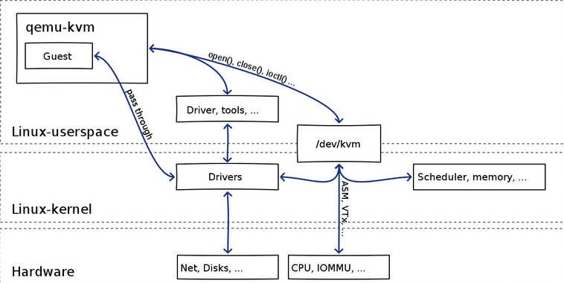
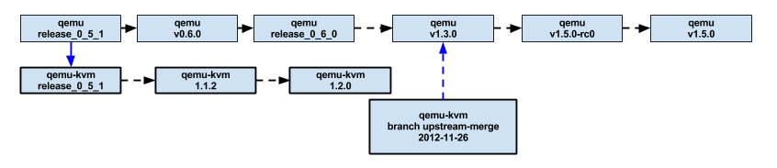
1.2 KVM Qemu Libvirt之间的关系
Qemu将KVM整合进来，通过ioctl调用/dev/kvm接口，将有关CPU指令的部分交由内核模块来做，就是qemu-kvm (qemu-system-XXX)
Qemu还会模拟其他的硬件，如Network, Disk，同样会影响这些设备的性能
于是产生pass through半虚拟化设备virtio_blk, virtio_net，提高设备性能
Qemu-kvm对kvm的整合从release_0_5_1开始有branch，在1.3.0正式merge到master

Slide 11
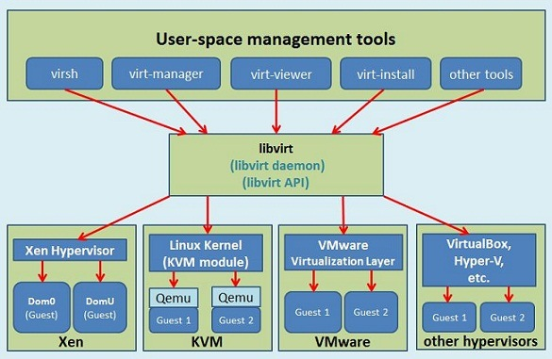
1.2 KVM Qemu Libvirt之间的关系
libvirt是目前使用最为广泛的对KVM虚拟机进行管理的工具和API

Slide 12
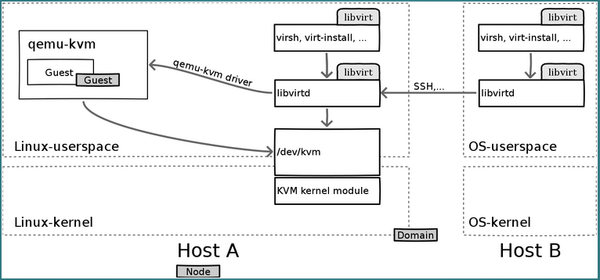
1.2 KVM Qemu Libvirt之间的关系
总结：
Libvirtd是一个daemon进程，可以被本地的virsh调用，也可以被远程的virsh调用
Libvirtd调用qemu-kvm操作虚拟机
有关CPU虚拟化的部分，qemu-kvm调用kvm的内核模块来实现

Slide 13
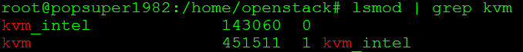
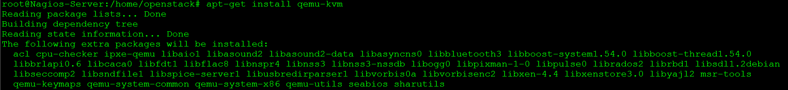
实验二：安装KVM, Qemu, Libvirt
查看内核模块中是否含有kvm, ubuntu默认加载这些模块
安装qemu-kvm

Slide 14
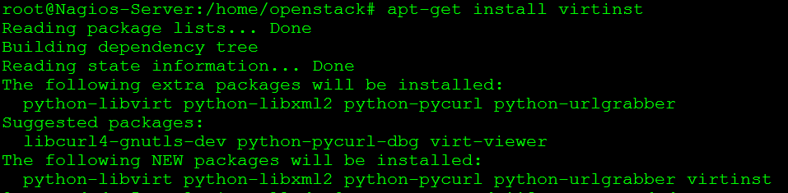
实验二：安装KVM, Qemu, Libvirt
安装libvirt
安装virt-install

Slide 15
Qemu-KVM
接下来的章节介绍qemu-kvm，先不介绍libvirt

Slide 16
2.1 QEMU-KVM: 安装第一个能上网的虚拟机
下载ubuntu的iso：http://www.ubuntu.com/download/cloud
创建Image
安装虚拟机
wget http://mirror.jmu.edu/pub/ubuntu-iso/14.04.1/ubuntu-14.04.1-server-amd64.iso
qemu-img create -f qcow2 ubuntutest.img 5G
qemu-system-x86_64 -enable-kvm -name ubuntutest -m 2048 -hda ubuntutest.img -cdrom ubuntu-14.04-server-amd64.iso -boot d -vnc :19

Slide 17
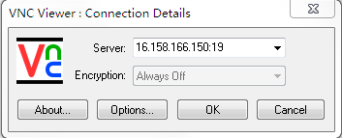
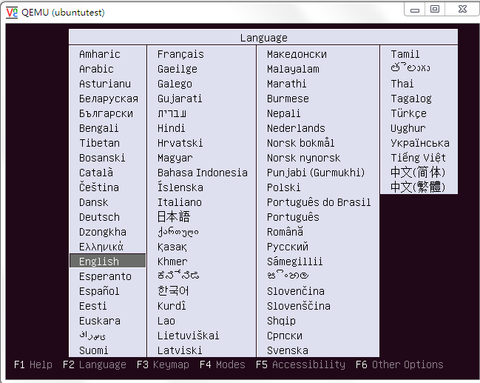
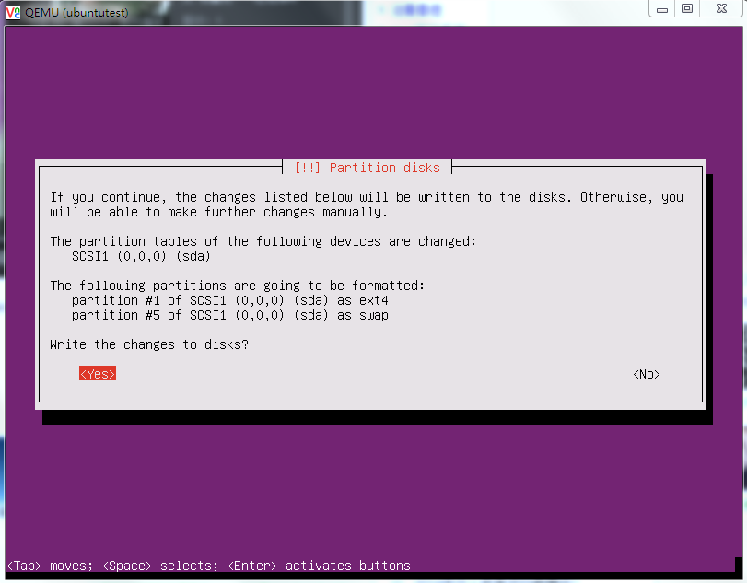
2.1 QEMU-KVM:安装第一个能上网的虚拟机
连接到VNC，按照普通安装ubuntu的流程安装好ubuntu

Slide 18
2.1 QEMU-KVM: 安装第一个能上网的虚拟机
重新启动后，从第一个硬盘boot，然后关机shutdown -h now
压缩硬盘，我们后面会做很多实验，所以备份一份
从ubuntutest.qcow2启动虚拟机
Qemu常用的网络配置
User Network
Tap + bridge network
qemu-img convert -O qcow2 -c ubuntutest.img ubuntutest.qcow2

Slide 19
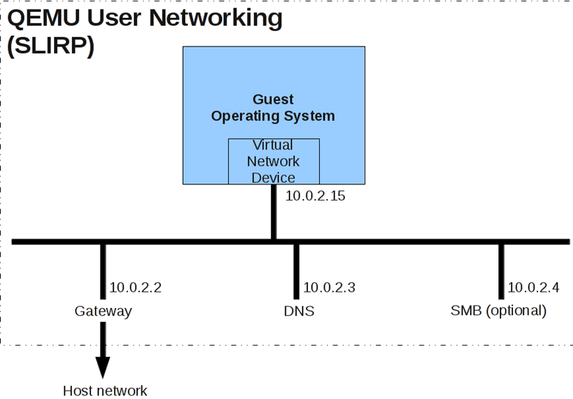
2.1 QEMU-KVM: 安装第一个能上网的虚拟机
User Network
默认配置，简单易用
性能较差
不支持ICMP
不能直接联网

Slide 20
2.1 QEMU-KVM:安装第一个能上网的虚拟机
配置Bridge Networking
这个课程和openvswitch无关，所以不用它
这里仅仅是简单的介绍，详细的后面会讲
(1) 在Host机器上创建bridge br0
(2) 将br0设为up
(3) 创建tap device
(4) 将tap0设为up
(5) 将tap0加入到br0上
brctl addbr br0
ip link set br0 up
tunctl -b
ip link set tap0 up
brctl addif br0 tap0

Slide 21
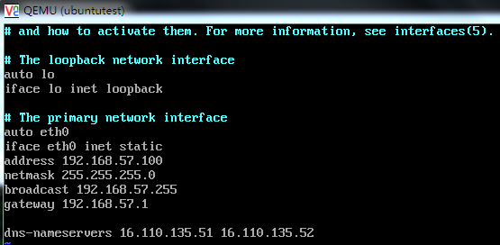
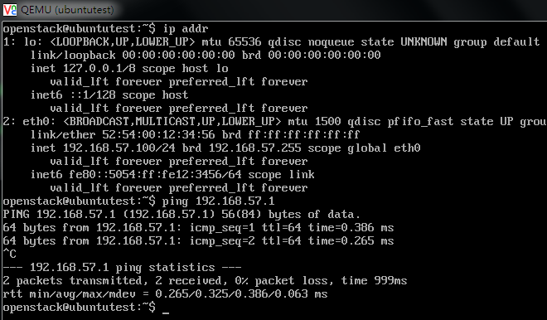
2.1 QEMU-KVM:安装第一个能上网的虚拟机
(6) 启动虚拟机, 虚拟机连接tap0, tap0连接br0
(7) 虚拟机启动后，网卡没有配置，所以无法连接外网，先给br0设置一个ip
(8) VNC连上虚拟机，给网卡设置地址，重启虚拟机，可ping通br0
qemu-system-x86_64 -enable-kvm -name ubuntutest -m 2048 -hda ubuntutest.qcow2 -vnc :19 -net nic,model=virtio -net tap,ifname=tap0,script=no,downscript=no
ifconfig br0 192.168.57.1/24

Slide 22
2.1 QEMU-KVM:安装第一个能上网的虚拟机
(9) 要想访问外网，在Host上设置NAT，并且enable ip forwarding，可以ping通外网网关
(10) 如果DNS没配错，可以进行apt-get update
# sysctl -p
net.ipv4.ip_forward = 1
sudo iptables -t nat -A POSTROUTING -o eth0 -j MASQUERADE

Slide 23
2.2 QEMU-KVM: 使用qemu monitor来管理虚拟机
访问qemu monitor console
用VNC连接到虚拟机, Ctrl+Alt+2进入，Ctrl+Alt+1返回普通console
在 QEMU 启动的时候指定 -monitor 参数。比如 -monitor stdio 将允许使用标准输入作为 monitor 命令源
Help可以查看所有的命令
这里列一个总表，在以后对虚拟机的管理中分别要用到
ACL
acl_add aclname match allow|deny [index]
acl_policy aclname allow|deny
acl_remove aclname match
acl_reset aclname
acl_show aclname
qemu-system-x86_64 -enable-kvm -name ubuntutest -m 2048 -hda ubuntutest.qcow2 -vnc :19 -net nic,model=virtio -net tap,ifname=tap0,script=no,downscript=no -monitor stdio
Notes:
root@popsuper1982:/home/openstack/images# qemu-system-x86_64 -enable-kvm -name ubuntutest -m 2048 -hda ubuntutest.qcow2 -vnc :19 -net nic,model=virtio -net tap,ifname=tap0,script=no,downscript=no -monitor stdio
QEMU 2.0.0 monitor - type 'help' for more information
(qemu) help
acl_add aclname match allow|deny [index] -- add a match rule to the access control list
acl_policy aclname allow|deny -- set default access control list policy
acl_remove aclname match -- remove a match rule from the access control list
acl_reset aclname -- reset the access control list
acl_show aclname -- list rules in the access control list
balloon target -- request VM to change its memory allocation (in MB)
block_job_cancel [-f] device -- stop an active background block operation (use -f
if the operation is currently paused)
block_job_complete device -- stop an active background block operation
block_job_pause device -- pause an active background block operation
block_job_resume device -- resume a paused background block operation
block_job_set_speed device speed -- set maximum speed for a background block operation
block_passwd block_passwd device password -- set the password of encrypted block devices
block_resize device size -- resize a block image
block_set_io_throttle device bps bps_rd bps_wr iops iops_rd iops_wr -- change I/O throttle limits for a block drive
block_stream device [speed [base]] -- copy data from a backing file into a block device
boot_set bootdevice -- define new values for the boot device list
change device filename [format] -- change a removable medium, optional format
chardev-add args -- add chardev
chardev-remove id -- remove chardev
client_migrate_info protocol hostname port tls-port cert-subject -- send migration info to spice/vnc client
closefd closefd name -- close a file descriptor previously passed via SCM rights
commit device|all -- commit changes to the disk images (if -snapshot is used) or backing files
cpu index -- set the default CPU
cpu-add id -- add cpu
c|cont -- resume emulation
delvm tag|id -- delete a VM snapshot from its tag or id
device_add driver[,prop=value][,...] -- add device, like -device on the command line
device_del device -- remove device
drive_add [[<domain>:]<bus>:]<slot>
[file=file][,if=type][,bus=n]
[,unit=m][,media=d][,index=i]
[,cyls=c,heads=h,secs=s[,trans=t]]
[,snapshot=on|off][,cache=on|off]
[,readonly=on|off][,copy-on-read=on|off] -- add drive to PCI storage controller
drive_backup [-n] [-f] device target [format] -- initiates a point-in-time
copy for a device. The device's contents are
copied to the new image file, excluding data that
is written after the command is started.
The -n flag requests QEMU to reuse the image found
in new-image-file, instead of recreating it from scratch.
The -f flag requests QEMU to copy the whole disk,
so that the result does not need a backing file.
drive_del device -- remove host block device
drive_mirror [-n] [-f] device target [format] -- initiates live storage
migration for a device. The device's contents are
copied to the new image file, including data that
is written after the command is started.
The -n flag requests QEMU to reuse the image found
in new-image-file, instead of recreating it from scratch.
The -f flag requests QEMU to copy the whole disk,
so that the result does not need a backing file.
dump-guest-memory [-p] filename [begin] [length] -- dump guest memory to file
begin(optional): the starting physical address
length(optional): the memory size, in bytes
eject [-f] device -- eject a removable medium (use -f to force it)
expire_password protocol time -- set spice/vnc password expire-time
gdbserver [device] -- start gdbserver on given device (default 'tcp::1234'), stop with 'none'
getfd getfd name -- receive a file descriptor via SCM rights and assign it a name
help|? [cmd] -- show the help
host_net_add tap|user|socket|vde|netmap|dump [options] -- add host VLAN client
host_net_remove vlan_id name -- remove host VLAN client
hostfwd_add [vlan_id name] [tcp|udp]:[hostaddr]:hostport-[guestaddr]:guestport -- redirect TCP or UDP connections from host to guest (requires -net user)
hostfwd_remove [vlan_id name] [tcp|udp]:[hostaddr]:hostport -- remove host-to-guest TCP or UDP redirection
i /fmt addr -- I/O port read
info [subcommand] -- show various information about the system state
loadvm tag|id -- restore a VM snapshot from its tag or id
log item1[,...] -- activate logging of the specified items
logfile filename -- output logs to 'filename'
mce [-b] cpu bank status mcgstatus addr misc -- inject a MCE on the given CPU [and broadcast to other CPUs with -b option]
memsave addr size file -- save to disk virtual memory dump starting at 'addr' of size 'size'
migrate [-d] [-b] [-i] uri -- migrate to URI (using -d to not wait for completion)
-b for migration without shared storage with full copy of disk
-i for migration without shared storage with incremental copy of disk (base image shared between src and destination)
migrate_cancel -- cancel the current VM migration
migrate_set_cache_size value -- set cache size (in bytes) for XBZRLE migrations,the cache size will be rounded down to the nearest power of 2.
The cache size affects the number of cache misses.In case of a high cache miss ratio you need to increase the cache size
migrate_set_capability capability state -- Enable/Disable the usage of a capability for migration
migrate_set_downtime value -- set maximum tolerated downtime (in seconds) for migrations
migrate_set_speed value -- set maximum speed (in bytes) for migrations. Defaults to MB if no size suffix is specified, ie. B/K/M/G/T
mouse_button state -- change mouse button state (1=L, 2=M, 4=R)
mouse_move dx dy [dz] -- send mouse move events
mouse_set index -- set which mouse device receives events
nbd_server_add nbd_server_add [-w] device -- export a block device via NBD
nbd_server_start nbd_server_start [-a] [-w] host:port -- serve block devices on the given host and port
nbd_server_stop nbd_server_stop -- stop serving block devices using the NBD protocol
netdev_add [user|tap|socket|hubport|netmap],id=str[,prop=value][,...] -- add host network device
netdev_del id -- remove host network device
nmi -- inject an NMI on all guest's CPUs
o /fmt addr value -- I/O port write
object_add [qom-type=]type,id=str[,prop=value][,...] -- create QOM object
object_del id -- destroy QOM object
pcie_aer_inject_error [-a] [-c] id <error_status> [<tlp header> [<tlp header prefix>]] -- inject pcie aer error
-a for advisory non fatal error
-c for correctable error
<id> = qdev device id
<error_status> = error string or 32bit
<tlb header> = 32bit x 4
<tlb header prefix> = 32bit x 4
pmemsave addr size file -- save to disk physical memory dump starting at 'addr' of size 'size'
p|print /fmt expr -- print expression value (use $reg for CPU register access)
qemu-io [device] "[command]" -- run a qemu-io command on a block device
q|quit -- quit the emulator
ringbuf_read device size -- Read from a ring buffer character device
ringbuf_write device data -- Write to a ring buffer character device
savevm [tag|id] -- save a VM snapshot. If no tag or id are provided, a new snapshot is created
screendump filename -- save screen into PPM image 'filename'
sendkey keys [hold_ms] -- send keys to the VM (e.g. 'sendkey ctrl-alt-f1', default hold time=100 ms)
set_link name on|off -- change the link status of a network adapter
set_password protocol password action-if-connected -- set spice/vnc password
singlestep [on|off] -- run emulation in singlestep mode or switch to normal mode
snapshot_blkdev [-n] device [new-image-file] [format] -- initiates a live snapshot
of device. If a new image file is specified, the
new image file will become the new root image.
If format is specified, the snapshot file will
be created in that format.
The default format is qcow2. The -n flag requests QEMU
to reuse the image found in new-image-file, instead of
recreating it from scratch.
snapshot_blkdev_internal device name -- take an internal snapshot of device.
The format of the image used by device must
support it, such as qcow2.
snapshot_delete_blkdev_internal device name [id] -- delete an internal snapshot of device.
If id is specified, qemu will try delete
the snapshot matching both id and name.
The format of the image used by device must
support it, such as qcow2.
stop -- stop emulation
stopcapture capture index -- stop capture
sum addr size -- compute the checksum of a memory region
system_powerdown -- send system power down event
system_reset -- reset the system
system_wakeup -- wakeup guest from suspend
trace-event name on|off -- changes status of a specific trace event
usb_add device -- add USB device (e.g. 'host:bus.addr' or 'host:vendor_id:product_id')
usb_del device -- remove USB device 'bus.addr'
watchdog_action [reset|shutdown|poweroff|pause|debug|none] -- change watchdog action
wavcapture path [frequency [bits [channels]]] -- capture audio to a wave file (default frequency=44100 bits=16 channels=2)
x /fmt addr -- virtual memory dump starting at 'addr'
xp /fmt addr -- physical memory dump starting at 'addr'

Slide 24
2.2 QEMU-KVM: 使用qemu monitor来管理虚拟机
Memory
balloon target: request VM to change its memory allocation
dump-guest-memory [-p] filename [begin] [length]
memsave addr size file: save to disk virtual memory dump
pmemsave addr size file: save to disk physical memory dump
sum addr size: compute the checksum of a memory region
x /fmt addr: virtual memory dump starting at 'addr'
xp /fmt addr: physical memory dump starting at 'addr‘
CPU
cpu index -- set the default CPU
cpu-add id -- add cpu
Device
device_add driver[,prop=value][,...]
device_del device
change device filename [format]
eject [-f] device
boot_set bootdevice
commit device|all

Slide 25
2.2 QEMU-KVM: 使用qemu monitor来管理虚拟机
Drive
drive_add
drive_backup [-n] [-f] device target [format]
drive_del device
drive_mirror [-n] [-f] device target [format]
Block Device
block_passwd block_passwd device password
block_resize device size
block_set_io_throttle device bps bps_rd bps_wr iops iops_rd iops_wr
block_stream device [speed [base]]
block_job_cancel [-f] device
block_job_complete device
block_job_pause device
block_job_resume device
block_job_cancel [-f] device
Drive和Block的区别是Drive是站在HOST的角度来看的，Block Device是站在虚拟机的角度去看的

Slide 26
2.2 QEMU-KVM: 使用qemu monitor来管理虚拟机
Character Device
chardev-add args -- add chardev
chardev-remove id -- remove chardev
VNC
set_password protocol password: set spice/vnc password
expire_password protocol time: set spice/vnc password expire-time
Mouse
mouse_button state: change mouse button state (1=L, 2=M, 4=R)
mouse_move dx dy [dz] : send mouse move events
mouse_set index : set which mouse device receives events

Slide 27
2.2 QEMU-KVM: 使用qemu monitor来管理虚拟机
Snapshot
savevm [tag|id] -- save a VM snapshot.
loadvm tag|id -- restore a VM snapshot
delvm tag|id -- delete a VM snapshot
snapshot_blkdev_internal device name -- take an internal snapshot of device.
snapshot_delete_blkdev_internal device name [id] -- delete an internal snapshot of device.
snapshot_blkdev [-n] device [new-image-file] [format] -- initiates a live snapshot of device. If a new image file is specified, the new image file will become the new root image.
Network Block Device
nbd_server_add nbd_server_add [-w] device -- export a block device via NBD
nbd_server_start nbd_server_start [-a] [-w] host:port -- serve block devices on the given host and port
nbd_server_stop nbd_server_stop -- stop serving block devices using the NBD protocol

Slide 28
2.2 QEMU-KVM: 使用qemu monitor来管理虚拟机
Network
host_net_add tap|user|socket|vde|netmap|dump [options] -- add host VLAN client
host_net_remove vlan_id name -- remove host VLAN client
hostfwd_add [vlan_id name] [tcp|udp]:[hostaddr]:hostport-[guestaddr]:guestport -- redirect TCP or UDP connections from host to guest (requires -net user)
hostfwd_remove [vlan_id name] [tcp|udp]:[hostaddr]:hostport -- remove host-to-guest TCP or UDP redirection
netdev_add [user|tap|socket|hubport|netmap],id=str[,prop=value][,...] -- add host network device
netdev_del id -- remove host network device
set_link name on|off -- change the link status of a network adapter
USB
usb_add device -- add USB device (e.g. 'host:bus.addr' or 'host:vendor_id:product_id')
usb_del device -- remove USB device 'bus.addr'

Slide 29
2.2 QEMU-KVM: 使用qemu monitor来管理虚拟机
Migrate
migrate [-d] [-b] [-i] uri -- migrate to URI
migrate_cancel -- cancel the current VM migration
migrate_set_cache_size value -- set cache size (in bytes)
migrate_set_capability capability state -- Enable/Disable the usage of a capability for migration
migrate_set_downtime value -- set maximum tolerated downtime (in seconds) for migrations
migrate_set_speed value -- set maximum speed (in bytes) for migrations.
System
system_powerdown -- send system power down event
system_reset -- reset the system
system_wakeup -- wakeup guest from suspend

Slide 30
实验三：使用qemu monitor查看信息
(qemu) info
info balloon -- show balloon information
info block [-v] [device] -- show info of one block device or all block devices (and details of images with -v option)
info block-jobs -- show progress of ongoing block device operations
info blockstats -- show block device statistics
info capture -- show capture information
info chardev -- show the character devices
info cpus -- show infos for each CPU
info cpustats -- show CPU statistics
info history -- show the command line history
info irq -- show the interrupts statistics (if available)
info jit -- show dynamic compiler info
info kvm -- show KVM information
info mem -- show the active virtual memory mappings
info mice -- show which guest mouse is receiving events
info migrate -- show migration status
info migrate_cache_size -- show current migration xbzrle cache size
info migrate_capabilities -- show current migration capabilities
info mtree -- show memory tree
info name -- show the current VM name
info network -- show the network state
info numa -- show NUMA information

Slide 31
实验三：使用qemu monitor查看信息
info pci -- show PCI info
info pcmcia -- show guest PCMCIA status
info pic -- show i8259 (PIC) state
info profile -- show profiling information
info qdm -- show qdev device model list
info qtree -- show device tree
info registers -- show the cpu registers
info roms -- show roms
info snapshots -- show the currently saved VM snapshots
info spice -- show the spice server status
info status -- show the current VM status (running|paused)
info tlb -- show virtual to physical memory mappings
info tpm -- show the TPM device
info trace-events -- show available trace-events & their state
info usb -- show guest USB devices
info usbhost -- show host USB devices
info usernet -- show user network stack connection states
info uuid -- show the current VM UUID
info version -- show the version of QEMU
info vnc -- show the vnc server status

Slide 32
实验三：使用qemu monitor查看信息
查看CPU: 每个CPU对应于HOST上的一个线程

Slide 33
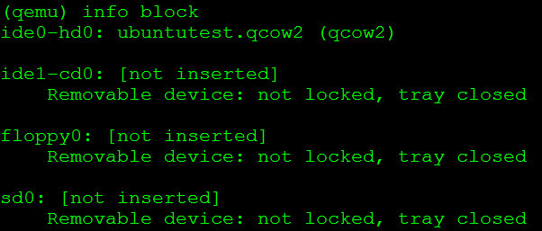
实验三：使用qemu monitor查看信息
查看Block设备: 看到Image文件
查看Block Status
查看Network

Slide 34
实验三：使用qemu monitor查看信息
查看所有的Device
info qtree

Slide 35
2.3 QEMU-KVM: qemu的硬件虚拟化
Qemu可以模拟物理计算机常用的硬件设备
计算机体系结构
CPU
SMP对称多处理器
System Management BIOS
内存
System Clock
USB
设备总线
显示器
声卡
网卡
CD-ROM
硬盘

Slide 36
Openstack虚拟机的参数
qemu-system-x86_64
-enable-kvm
-name instance-00000024
-machine pc-i440fx-trusty,accel=kvm,usb=off
-cpu SandyBridge,+erms,+smep,+fsgsbase,+pdpe1gb,+rdrand,+f16c,+osxsave,+dca,+pcid,+pdcm,+xtpr,+tm2,+est,+smx,+vmx,+ds_cpl,+monitor,+dtes64,+pbe,+tm,+ht,+ss,+acpi,+ds,+vme
-m 2048 -realtime mlock=off
-smp 1,sockets=1,cores=1,threads=1
-uuid 1f8e6f7e-5a70-4780-89c1-464dc0e7f308
-smbios type=1,manufacturer=OpenStack Foundation,product=OpenStack Nova,version=2014.1,serial=80590690-87d2-e311-b1b0-a0481cabdfb4,uuid=1f8e6f7e-5a70-4780-89c1-464dc0e7f308
-no-user-config
-nodefaults
-chardev socket,id=charmonitor,path=/var/lib/libvirt/qemu/instance-00000024.monitor,server,nowait
-mon chardev=charmonitor,id=monitor,mode=control
-rtc base=utc,driftfix=slew
-global kvm-pit.lost_tick_policy=discard
-no-hpet
-no-shutdown
-boot strict=on
-device piix3-usb-uhci,id=usb,bus=pci.0,addr=0x1.0x2
-drive file=/var/lib/nova/instances/1f8e6f7e-5a70-4780-89c1-464dc0e7f308/disk,if=none,id=drive-virtio-disk0,format=qcow2,cache=none
-device virtio-blk-pci,scsi=off,bus=pci.0,addr=0x4,drive=drive-virtio-disk0,id=virtio-disk0,bootindex=1
-netdev tap,fd=32,id=hostnet0,vhost=on,vhostfd=37
-device virtio-net-pci,netdev=hostnet0,id=net0,mac=fa:16:3e:d1:2d:99,bus=pci.0,addr=0x3
-chardev file,id=charserial0,path=/var/lib/nova/instances/1f8e6f7e-5a70-4780-89c1-464dc0e7f308/console.log
-device isa-serial,chardev=charserial0,id=serial0
-chardev pty,id=charserial1
-device isa-serial,chardev=charserial1,id=serial1
-device usb-tablet,id=input0
-vnc 0.0.0.0:12
-k en-us
-device cirrus-vga,id=video0,bus=pci.0,addr=0x2
-device virtio-balloon-pci,id=balloon0,bus=pci.0,addr=0x5

Slide 37
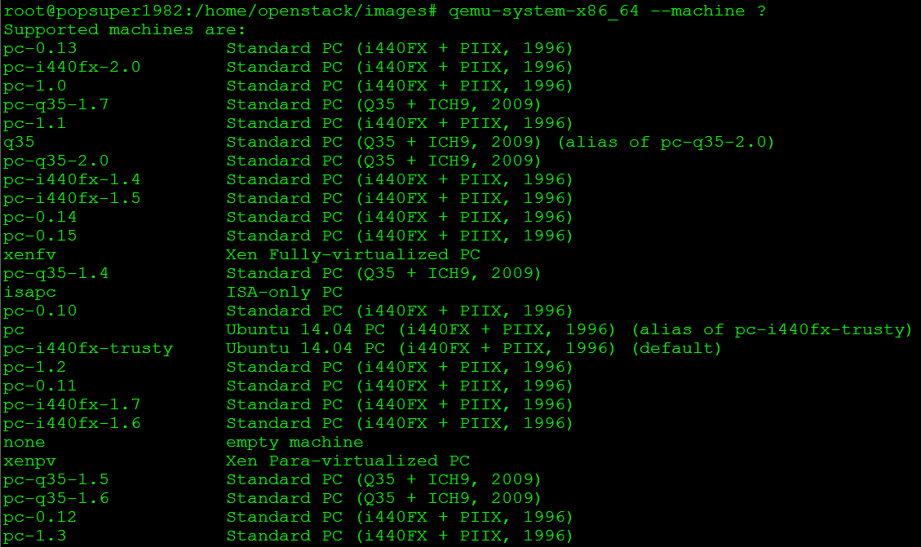
2.3 QEMU-KVM: qemu的硬件虚拟化
计算机体系结构
QEMU会模拟多种Processor architectures，常用的有：
PC (x86 or x86_64 processor)
Mac99 PowerMac (PowerPC processor)
Sun4u/Sun4v (64-bit Sparc processor)
MIPS magnum (64-bit MIPS processor)
qemu-system-x86_64 --machine ?
所以在命令行中有
-machine pc-i440fx-trusty,accel=kvm,usb=off
如果使用KVM hardware-assisted virtualization，也即BIOS中VD-T是打开的，则参数中accel=kvm
如果不使用hardware-assisted virtualization，用的是纯模拟，则有参数accel = tcg，-no-kvm

Slide 38
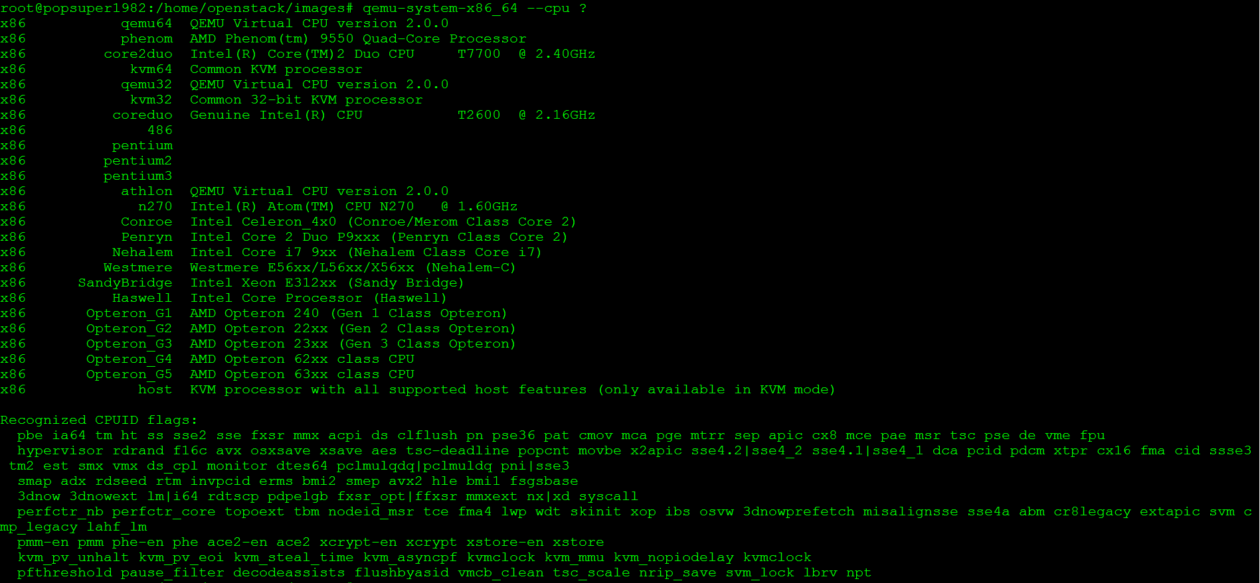
2.3 QEMU-KVM: qemu的硬件虚拟化
CPU
下面的命令可以列出支持的CPU：qemu-system-x86_64 --cpu ?
所以参数中有下面的CPU设置及添加的flag
-cpu SandyBridge,+erms,+smep,+fsgsbase,+pdpe1gb,+rdrand,+f16c,+osxsave,+dca,+pcid,+pdcm,+xtpr,+tm2,+est,+smx,+vmx,+ds_cpl,+monitor,+dtes64,+pbe,+tm,+ht,+ss,+acpi,+ds,+vme

Slide 39
2.3 QEMU-KVM: qemu的硬件虚拟化
SMP对称多处理器
对称多处理"（Symmetrical Multi-Processing）简称SMP，是指在一个计算机上汇集了一组处理器(多CPU),各CPU之间共享内存子系统以及总线结构。
QEMU and KVM 可以最多模拟SMP到255个CPU.
我们的参数中有-smp 1,sockets=1,cores=1,threads=1
qemu仿真了一个具有1个vcpu，一个socket，一个core，一个threads的处理器。
socket, core, threads是什么概念呢
socket就是主板上插cpu的槽的数目，也即常说的“路”
core就是我们平时说的“核”，即双核，4核等
thread就是每个core的硬件线程数，即超线程
具体例子，某个服务器是：2路4核超线程(一般默认为2个线程)，通过cat /proc/cpuinfo看到的是2*4*2=16个processor，很多人也习惯成为16核了！

Slide 40
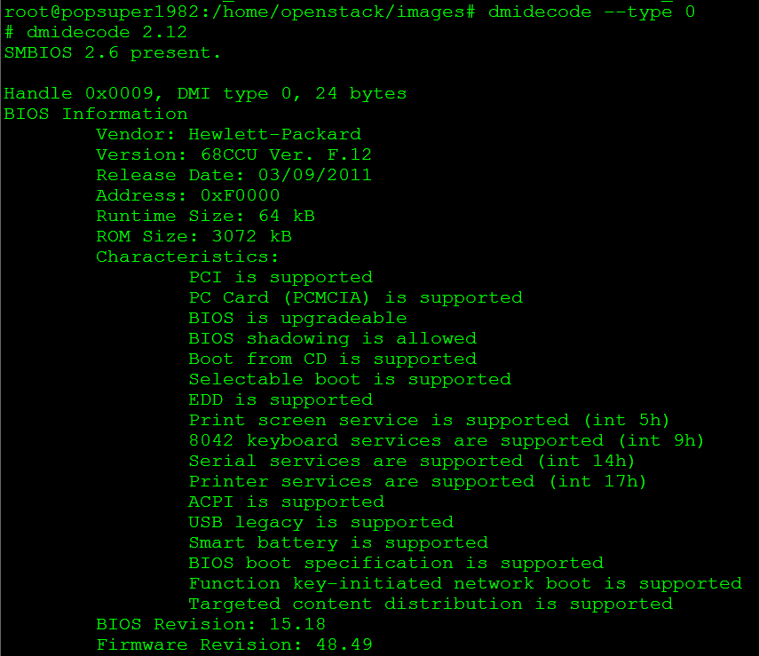
2.3 QEMU-KVM: qemu的硬件虚拟化
SMBIOS
SMBIOS全称System Management BIOS，用于表示x86 architectures的硬件信息
在unix系统上，可以使用命令dmidecode得到，SMBIOS的信息被分为多个table中，称为type
type 0是BIOS信息

Slide 41
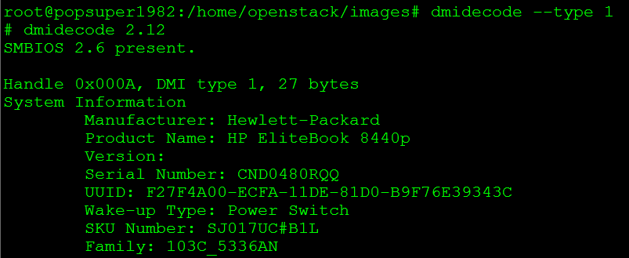
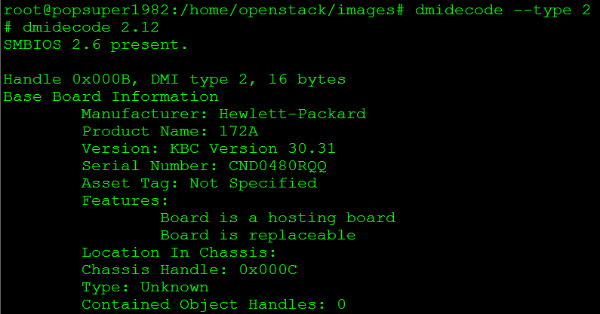
2.3 QEMU-KVM: qemu的硬件虚拟化
type 1是系统信息
type 2是主板信息
所以有参数
-smbios type=1,manufacturer=OpenStack Foundation,product=OpenStack Nova,version=2014.1,serial=80590690-87d2-e311-b1b0-a0481cabdfb4,uuid=1f8e6f7e-5a70-4780-89c1-464dc0e7f308
指定了type 1的信息

Slide 42
2.3 QEMU-KVM: qemu的硬件虚拟化
RAM
内存的大小在参数中，用-m来指定
-m 2048
guest真正运行态的占用的内存的大小，是用Memory Ballooning来调整
-device virtio-balloon-pci,id=balloon0,bus=pci.0,addr=0x5
ACPI (Advanced Configuration and Power Interface)
open industry standard for power management
ACPI disabled with the option -no-acpi
System Clock
系统时间由参数-rtc指定 -rtc [base = utc | localtime | date] [, clock = host | vm] [, driftfix = none | slew]
High Precision Event Timer (HPET)是可以更准确的设定时间的
-rtc base=utc,driftfix=slew
-no-hpet

Slide 43
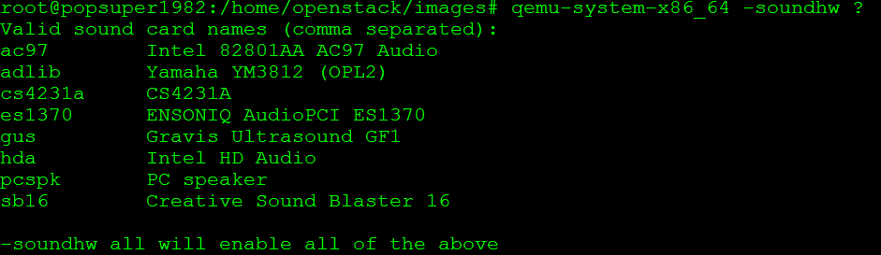
2.3 QEMU-KVM: qemu的硬件虚拟化
USB
USB的好处就是即插即用
参数-usb，可以模拟一个PCI UHCI USB控制器
参数里面看到的是
-device usb-tablet,id=input0
通过tablet，鼠标可以在HOST和GUEST机器之间自由的切换
显示器
用参数-vga设置，默认为cirrus，它模拟了CL-GD5446 PCI VGA card
-device cirrus-vga,id=video0,bus=pci.0,addr=0x2
声卡

Slide 44
2.3 QEMU-KVM: qemu的硬件虚拟化
网卡
使用-net参数和-device
从HOST角度：-netdev tap,fd=32,id=hostnet0,vhost=on,vhostfd=37
从GUEST角度：-device virtio-net-pci,netdev=hostnet0,id=net0,mac=fa:16:3e:d1:2d:99,bus=pci.0,addr=0x3
硬盘
使用-hda -hdb
使用-drive和-device
从HOST角度：-drive file=/var/lib/nova/instances/1f8e6f7e-5a70-4780-89c1-464dc0e7f308/disk,if=none,id=drive-virtio-disk0,format=qcow2,cache=none
从GUEST角度：-device virtio-blk-pci,scsi=off,bus=pci.0,addr=0x4,drive=drive-virtio-disk0,id=virtio-disk0,bootindex=1
CDROM
使用-cdrom
如果想直接挂载Host机器上的CD-ROM -cdrom /dev/cdrom

Slide 45
2.3 QEMU-KVM: qemu的硬件虚拟化
Character Device: console的log
从HOST角度：-chardev file,id=charserial0,path=/var/lib/nova/instances/1f8e6f7e-5a70-4780-89c1-464dc0e7f308/console.log
从GUEST角度：-device isa-serial,chardev=charserial0,id=serial0
当然需要在image里面做如下的配置才能将boot log写入console
/boot/grub/grub.cfg中有
linux /boot/vmlinuz-3.2.0-49-virtual root=UUID=6d2231e4-0975-4f35-a94f-56738c1a8150 ro console=ttyS0
Character Device: PTY
-chardev pty,id=charserial1
-device isa-serial,chardev=charserial1,id=serial1
VNC
-vnc 0.0.0.0:12

Slide 46
2.3 QEMU-KVM: qemu的硬件虚拟化
PCI(Peripheral Component Interconnect)是设备总线标准
在参数中常看到bus和addr，是PCI总线的概念
一个PCI子系统包含四个模块
Bus
最多256个Bus，常用的是Bus 0和Bus 1
Device
Device就是连接到Bus上的设备，如声卡，网卡等，最多32个
Function
每个Device有至少有一个Function 0，最多8个
Register
每个Function有256 eight-bit registers
-device piix3-usb-uhci,id=usb,bus=pci.0,addr=0x1.0x2表示：
连接到Bus的pci.0
是这个Bus的第一个Device, 0x1
是这个Device的第二个Function, 0x2，如果只有一个Function，这个数字可以忽略

Slide 47
2.3 QEMU-KVM: qemu的硬件虚拟化
Bus 0, device 2, function 0:
VGA controller: PCI device 1013:00b8
BAR0: 32 bit prefetchable memory at 0xfc000000 [0xfdffffff].
BAR1: 32 bit memory at 0xfebd0000 [0xfebd0fff].
BAR6: 32 bit memory at 0xffffffffffffffff [0x0000fffe].
id "video0"
Bus 0, device 3, function 0:
Ethernet controller: PCI device 1af4:1000
IRQ 11.
BAR0: I/O at 0xc060 [0xc07f].
BAR1: 32 bit memory at 0xfebd1000 [0xfebd1fff].
BAR6: 32 bit memory at 0xffffffffffffffff [0x0003fffe].
id "net0"
Bus 0, device 4, function 0:
SCSI controller: PCI device 1af4:1001
IRQ 11.
BAR0: I/O at 0xc000 [0xc03f].
BAR1: 32 bit memory at 0xfebd2000 [0xfebd2fff].
id "virtio-disk0"
Bus 0, device 5, function 0:
Class 0255: PCI device 1af4:1002
IRQ 10.
BAR0: I/O at 0xc080 [0xc09f].
id "balloon0"
在monitor中info pci
Bus 0, device 0, function 0:
Host bridge: PCI device 8086:1237
id ""
Bus 0, device 1, function 0:
ISA bridge: PCI device 8086:7000
id ""
Bus 0, device 1, function 1:
IDE controller: PCI device 8086:7010
BAR4: I/O at 0xc0a0 [0xc0af].
id ""
Bus 0, device 1, function 2:
USB controller: PCI device 8086:7020
IRQ 11.
BAR4: I/O at 0xc040 [0xc05f].
id "usb"
Bus 0, device 1, function 3:
Bridge: PCI device 8086:7113
IRQ 9.
id ""
显示器
-device cirrus-vga,id=video0,bus=pci.0,addr=0x2
网卡
-device virtio-net-pci,netdev=hostnet0,id=net0,
mac=fa:16:3e:d1:2d:99,bus=pci.0,addr=0x3
USB
硬盘
-device virtio-blk-pci,scsi=off,bus=pci.0,
addr=0x4,drive=drive-virtio-disk0,
id=virtio-disk0,bootindex=1
内存
-device piix3-usb-uhci,
id=usb,bus=pci.0,addr=0x1.0x2
-device virtio-balloon-pci,id=balloon0,
bus=pci.0,addr=0x5

Slide 48
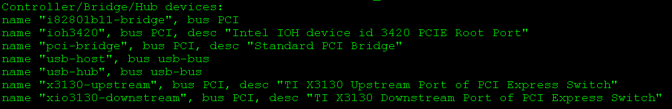
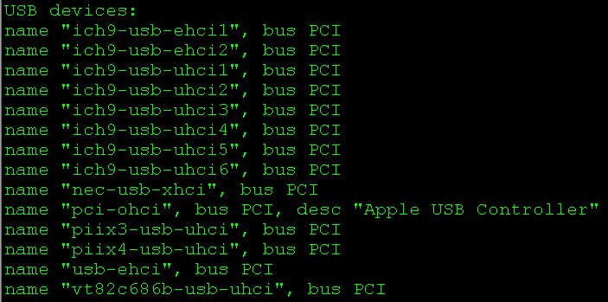
实验四：查看qemu所能模拟的设备
qemu-system-x86_64 -device ?

Slide 49
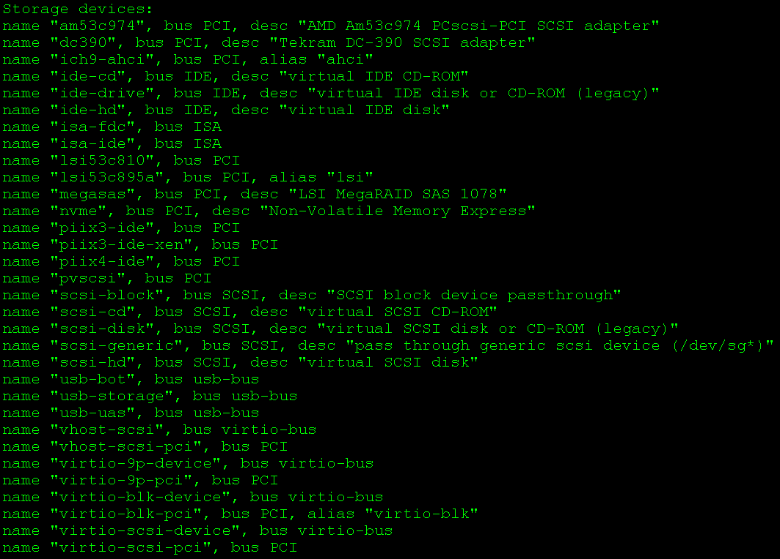
实验四：查看qemu所能模拟的设备

Slide 50
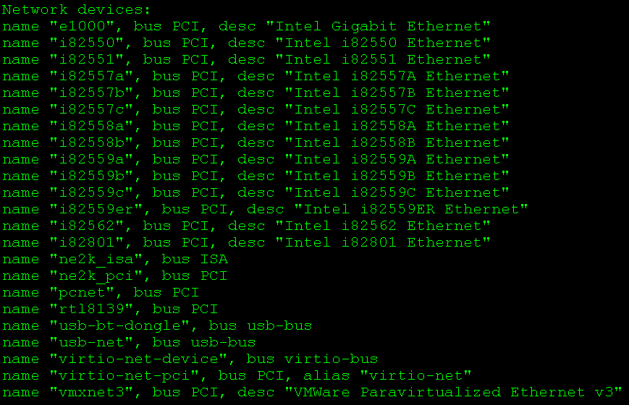
实验四：查看qemu所能模拟的设备

Slide 51
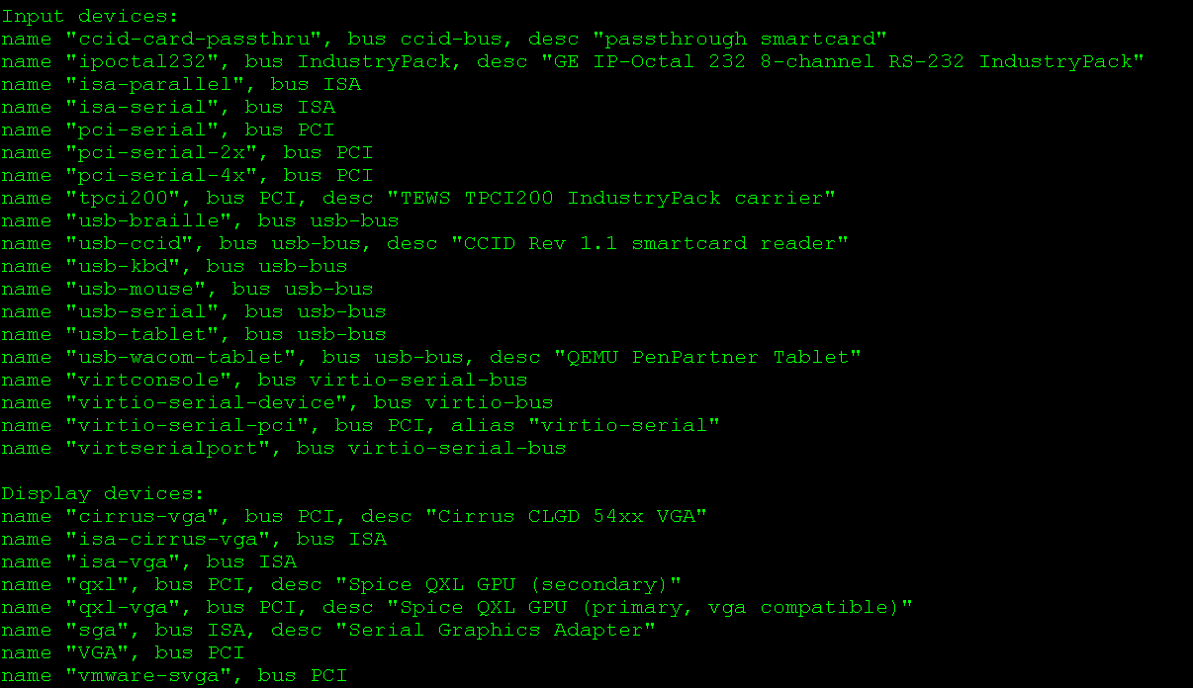
实验四：查看qemu所能模拟的设备

Slide 52
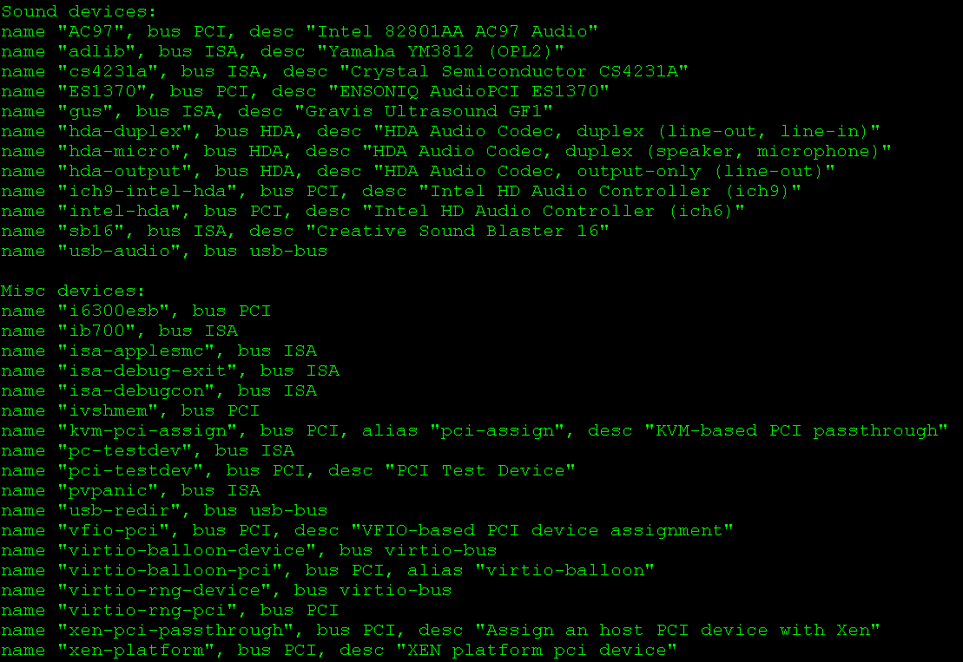
实验四：查看qemu所能模拟的设备

Slide 53
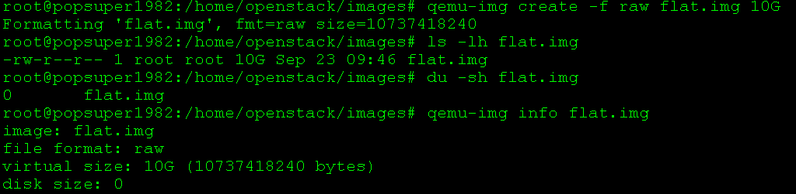
2.4 QEMU-KVM: Images
RAW Image
格式简单，性能较好
需要文件系统的支持才能支持sparse file，所以最好基于ext3
创建image
Notes:
Image formats
Creating Images
Convert Images, compress, encrypt and enlarge
Physical-to-Virtual

Slide 54
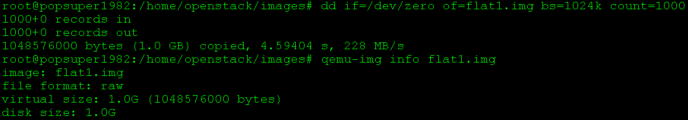
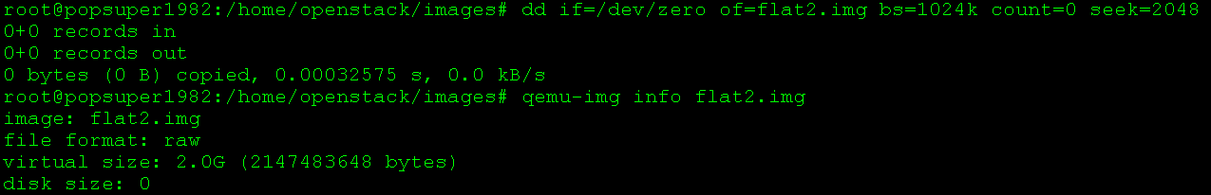
2.4 QEMU-KVM: Images
用dd产生image
产生non sparse file
dd if=/dev/zero of=flat1.img bs=1024k count=1000
block size是1024k，共1000个block
产生sparse file
dd if=/dev/zero of=flat2.img bs=1024k count=0 seek=2048
seek的意思是将文件的结尾设在那个地方

Slide 55
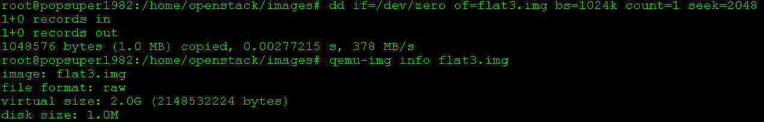
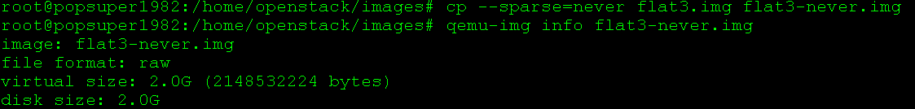
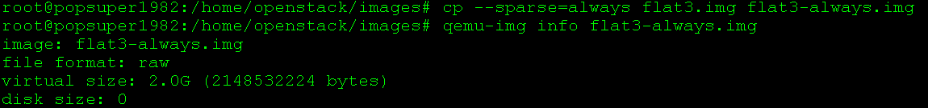
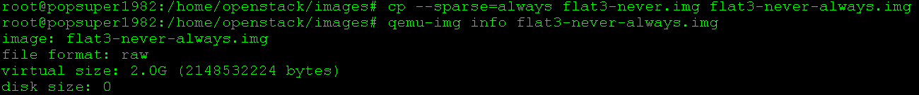
2.4 QEMU-KVM: Images
copy一个sparse文件
dd if=/dev/zero of=flat3.img bs=1024k count=1 seek=2048
cp --sparse=never flat3.img flat3-never.img
这样拷贝会占用整个2G空间
cp --sparse=always flat3.img flat3-always.img
这样拷贝原来写入的1M的0也会被去掉
cp --sparse=always flat3-never.img flat3-never-always.img
这样拷贝原来的2G都会被清理掉

Slide 56
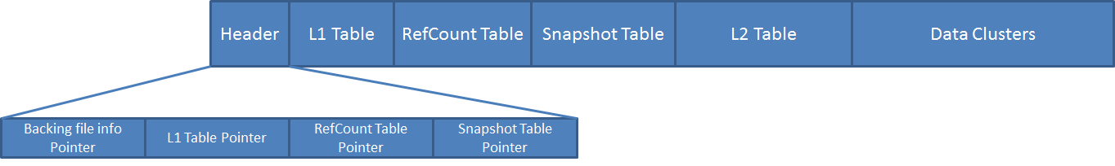
2.4 QEMU-KVM: Images
qcow2是动态的
即便文件系统不支持sparse file，文件大小也很小
Copy on write
Snapshot
压缩
加密
qcow2的格式

Slide 57
2.4 QEMU-KVM: Images
2-Level loopup
qcow2的数据是存储在data clusters里面的，每个cluster是512 byte sector
为了能够管理这些cluster，qcow2保存了两层的Table，L1 table指向L2 Table，L2 Table管理data cluster.
在image里面的offset会被解析成三部分，L1 Table Pointer先找L1，L1 Table Pointer+ offset[0]是L1中的一个entry，读出来便是L2 Table Pointer, L2 Table Pointer + offset[1]是L2中的一个entry，读出来便是data cluster pointer, data cluster pointer +offset[3]便是数据所在的位置。

Slide 58
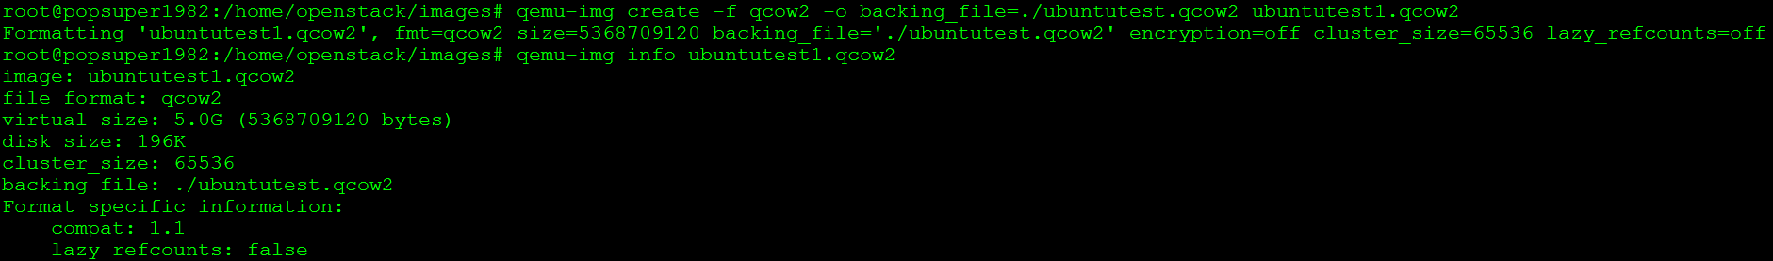
2.4 QEMU-KVM: Images
Copy-on-write
backing file就是基于这个原理的用处，一个qcow2的image可以保存另一个disk image的改变，而不影响另一个image
创建backing file
qemu-img create -f qcow2 -o backing_file=./ubuntutest.qcow2 ubuntutest1.qcow2
一开始新的image是空的，读取的内容都从老的image里面读取。
当一个data cluster被写入，发生改变的时候，在新的image里面创建一个新的data cluster，这就是copy on write的意义。

Slide 59
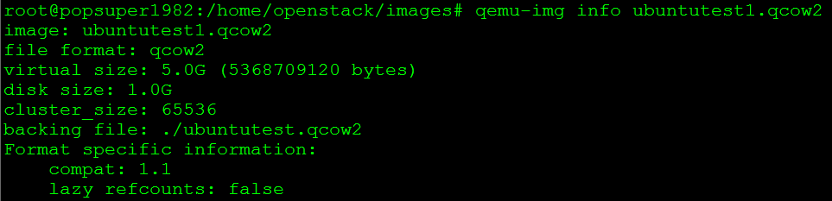
2.4 QEMU-KVM: Images
基于ubuntutest1.img创建一个虚拟机
qemu-system-x86_64 -enable-kvm -name ubuntutest -m 2048 -hda ubuntutest1.qcow2 -vnc :19 -net nic,model=virtio -net tap,ifname=tap0,script=no,downscript=no -monitor stdio
在虚拟机里面创建一个1G的non sparse file
dd if=/dev/zero of=flat1.img bs=1024k count=1000

Slide 60
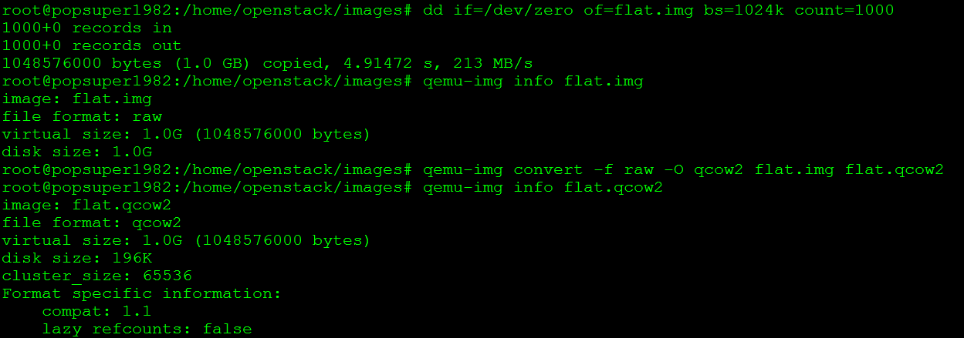
2.4 QEMU-KVM: Images
Convert: image格式之间可以转换
raw可以转换为qcow2
创建一个raw image: dd if=/dev/zero of=flat.img bs=1024k count=1000
进行转换： qemu-img convert -f raw -O qcow2 flat.img flat.qcow2
qcow2也可以转换为qcow2，转换的过程中，没用的data cluster就被去掉
qemu-img convert -f qcow2 -O qcow2 ubuntutest.img ubuntutest-convert.img

Slide 61
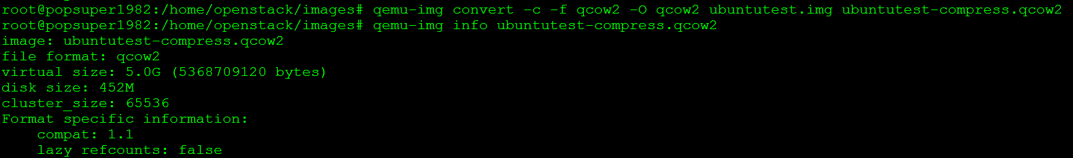
2.4 QEMU-KVM: Images
压缩compress
qemu-img convert -c -f qcow2 -O qcow2 ubuntutest.img ubuntutest-compress.qcow2

Slide 62
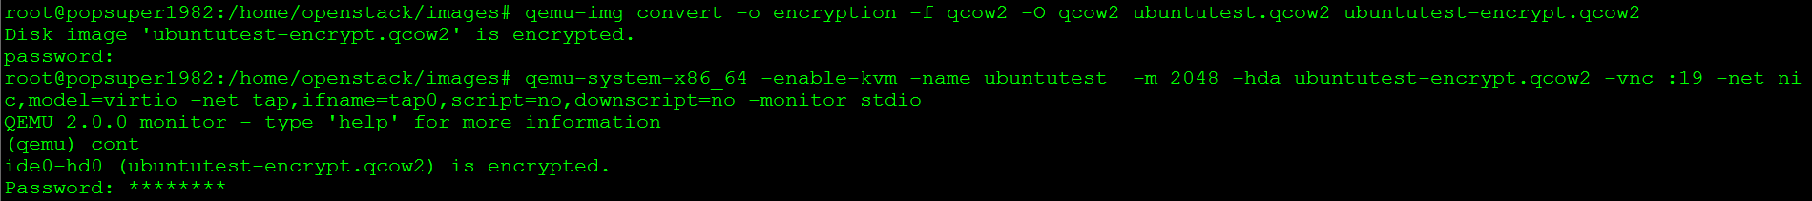
2.4 QEMU-KVM: Images
加密:
qemu-img convert -o encryption -f qcow2 -O qcow2 ubuntutest.qcow2 ubuntutest-encrypt.qcow2
会要求设置密码
从这个加密image启动一个虚拟机
qemu-system-x86_64 -enable-kvm -name ubuntutest -m 2048 -hda ubuntutest-encrypt.qcow2 -vnc :19 -net nic,model=virtio -net tap,ifname=tap0,script=no,downscript=no -monitor stdio
一开始虚拟机并不启动
在monitor中输入cont
需要输入密码后虚拟机才启动

Slide 63
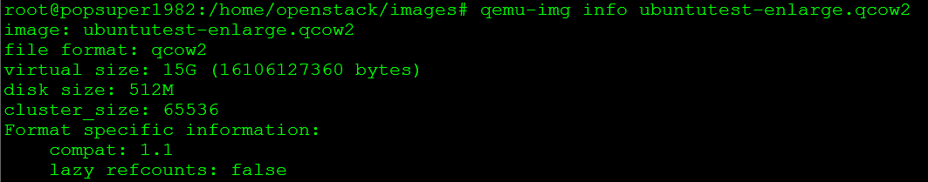
2.4 QEMU-KVM: Images
扩展
cp ubuntutest.qcow2 ubuntutest-enlarge.qcow2
qemu-img resize ubuntutest-enlarge.qcow2 +10G
扩大的空间既不会被partition，也不会被format
启动虚拟机
qemu-system-x86_64 -enable-kvm -name ubuntutest -m 2048 -hda ubuntutest-enlarge.qcow2 -vnc :19 -net nic,model=virtio -net tap,ifname=tap0,script=no,downscript=no -monitor stdio

Slide 64
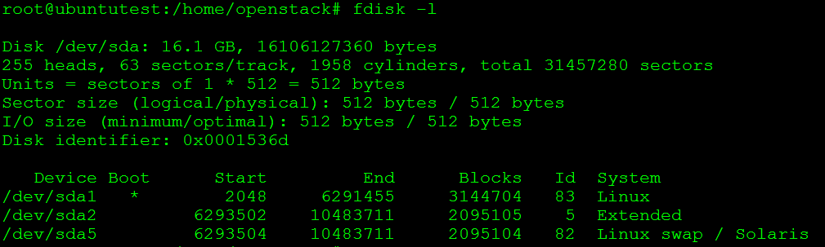
2.4 QEMU-KVM: Images
Disk已经被扩大
删除/dev/sda2和/dev/sda5
fdisk /dev/sda
删除分区五：d 5
删除分区二：d 2
写入修改：w
reboot

Slide 65

2.4 QEMU-KVM: Images
扩展/dev/sda1分区到整块硬盘
fdisk /dev/sda
删除根分区：d 1
在原来根分区的位置创建新分区：n
是一个主分区：p
其他都选默认，最后写入修改：w
partprobe
扩展文件系统
resize2fs /dev/sda1

Slide 66

2.5 QEMU-KVM: Snapshot
snapshot也是copy on write的一种应用，和backing file有微妙的不同
有两种snapshot，一中时internal snapshot，一种是external snapshot
internal snapshot是qcow2中的snapshot table所维护的snapshot，所有的snapshot都是在同一个文件中维护
创建一个虚拟机
qemu-system-x86_64 -enable-kvm -name ubuntutest -m 2048 -hda ubuntutest.qcow2 -vnc :19 -net nic,model=virtio -net tap,ifname=tap0,script=no,downscript=no -monitor stdio
在monitor中执行savevm后，ubuntutest.img会在image内部打一个snapshot

Slide 67
2.5 QEMU-KVM: Snapshot
原理是，当打一个snapshot后，会在snapshot table中建立一项，但是起初是空的，包含L1 table的一个复制，当L2 table或者data cluster改变的时候，则会将原来的数据复制一份，由snapshot的L1 table来维护，而原来的data cluster已经改变，在原地。
我们在/home/openstack下面创建一个文件夹
loadvm vm-20140923183123
文件夹消失了
删除snapshot
delvm vm-20140923183123

Slide 68


2.5 QEMU-KVM: Snapshot
external snapshot则往往采用上面的copy on write的方法
当打snapshot的时候，将当前的image不再改变，创建一个新的image，以原来的image作为backing file，然后虚拟机使用新的image
在monitor中，snapshot_blkdev ide0-hd0 ubuntutest-snapshot.img qcow2
在HOST机器上多了一个文件

Slide 69
2.5 QEMU-KVM: Snapshot
backing file可以是raw，也可以是qcow2，但是一旦打了snapshot，新的格式就是qcow2了。
两者很相似，稍微的不同是：
对于internal snapshot, 刚打完snapshot的时候，原image集合是不变的，snapshot的集合是空的，接下来的操作，写入在原image，将不变的加入snapshot集合
对于external snapshot，刚打完snapshot的时候，原image变成snapshot, snapshot集合是全集，新image是空的，接下来的操作，写入在新image，将改变的加入新image的集合。
qemu-img snapshot –c
if the domain is offline and –disk-only was not specified
savevm
if the domain is online and –disk-only was not specified
snapshot_blkdev
if the domain is online and –disk-only is specified

Slide 70
2.6 QEMU-KVM: Network Block Device
网络块设备是通过NBD Server将虚拟块设备通过TCP/IP export出来，可以远程访问。
NBD Server通常是qemu-nbd
方式一：可以提供unix socket
qemu-nbd -t -k /home/openstack/images/ubuntutest-nbd ubuntutest.img
连接这个unix socket
qemu-system-x86_64 -enable-kvm -name ubuntutest -m 2048 -hda nbd:unix:/home/openstack/images/ubuntutest-nbd -vnc :19 -net nic,model=virtio -net tap,ifname=tap0,script=no,downscript=n -monitor stdio
方式二：普通的socket连接
qemu-nbd -t -p 1088 ubuntutest.qcow2
qemu-system-x86_64 -enable-kvm -name ubuntutest -m 2048 -hda nbd:16.158.166.150:1088 -vnc :19 -net nic,model=virtio -net tap,ifname=tap0,script=no,downscript=n -monitor stdio

Slide 71

2.6 QEMU-KVM: Network Block Device
方式三：将image mount到一个network block device
查看内核是否编译进去NBD
查看内核模块信息modinfo nbd
查看内核模块是否加载lsmod | grep nbd
如果没有加载modprobe nbd，也可以指定最多的partition: modprobe nbd max_part=16
#grep NBD /boot/config-3.13.0-24-generic
CONFIG_BLK_DEV_NBD=m

Slide 72

2.6 QEMU-KVM: Network Block Device
加载后出现16个NBD
查看哪个nbd device被使用：cat /proc/partitions

Slide 73

2.6 QEMU-KVM: Network Block Device
将image付给一个network block device
qemu-nbd -c /dev/nbd0 ubuntutest.img
可以看到这个image里面有三个partition
Mount其中一个partition

Slide 74
2.6 QEMU-KVM: Network Block Device
修改结束后
umount ubuntutestnbd0p1
qemu-nbd -d /dev/nbd0

Slide 75


2.6 QEMU-KVM: Network Block Device
有LVM的情况相对复杂
qemu-nbd -c /dev/nbd0 centos-5.8.new.qcow2
发现里面有LVM，当然LVM不能作为整体访问，因为里面有Logic volume，都是单独成文件系统的
查看LVM的信息

Slide 76

2.6 QEMU-KVM: Network Block Device
Import这个volume group
vgimport VolGroup00
将这个volume group设为active
vgchange -ay VolGroup00
Mount其中一个LV
mount /dev/VolGroup00/LogVol00 ubuntutestnbd0p1/

Slide 77

2.6 QEMU-KVM: Network Block Device
修改结束后
umount ubuntutestnbd0p1/
vgchange -an VolGroup00
vgexport VolGroup00
qemu-nbd -d /dev/nbd0

Slide 78


2.7 QEMU-KVM: 访问iSCSI
iSCSI (Internet Small Computer Systems Interface)

Slide 79


2.7 QEMU-KVM: 访问iSCSI
在Server端：
创建Physical Volume: pvcreate /dev/vdb
创建Volume Group: vgcreate my-volume-group /dev/vdb
创建Logical Volume: lvcreate -L 8G -n my_logical_volume my-volume-group
将image写入LV:
qemu-img convert -O raw ubuntutest.qcow2 /dev/my-volume-group/my_logical_volume

Slide 80

2.7 QEMU-KVM: 访问iSCSI
在Server端
用tgt查看iscsi target：tgtadm --mode target --op show
创建一个iscsi target
tgtadm --lld iscsi --op new --mode target --tid 1 -T iqn.2014-09.org.openstack:my-iscsi-volume
将Logic Volume加入刚才创建的iscsi target
tgtadm --lld iscsi --op new --mode logicalunit --tid 1 --lun 1 -b /dev/my-volume-group/my_logical_volume
配置iscsi target监听链接
tgtadm --lld iscsi --op bind --mode target --tid 1 -I ALL

Slide 81

2.7 QEMU-KVM: 访问iSCSI
在客户端
discover这个iscsi target
iscsiadm --mode discovery --type sendtargets --portal 192.168.100.200
连接那个iscsi target
iscsiadm --mode node --targetname iqn.2014-09.org.openstack:my-iscsi-volume --portal 16.158.166.197:3260192.168.100.200:3260 –login
Qemu可以直接连接/dev/sdb

Slide 82

2.7 QEMU-KVM: 访问iSCSI
在客户端
Qemu也可以直接连接iSCSI
但是需要编译的时候，启动--enable-libiscsi，将libiscsi编译进去
然而默认的ubuntu下面的没有编译进去
ldd /usr/bin/qemu-system-x86_64
ISCSI Logout
iscsiadm --mode node --targetname iqn.2014-09.org.openstack:my-iscsi-volume --portal 192.168.100.200:3260 --logout

Slide 83
2.8 QEMU-KVM:网络虚拟化
网卡配置(Guest角度)：
-net nic[,vlan=n][,macaddr=mac][,model=type][,Name=str][,addr=str][,vectors=v]
VLAN和802.1.q一点关系都没有，就是virtual hub的概念，vlan参数表示连接在哪个virtual hub上
Virtual hub在同一个qemu进程中有效，属于同一个virtual hub的网卡可以彼此收到包
model有多种：
qemu-system-x86_64 -net nic,model=?
网络模式(Host角度)
-net user/socket/tap

Slide 84

2.8 QEMU-KVM:网络虚拟化
网络模式User Network： 如何对外通信？
hostfwd=[tcp|udp]:[hostaddr]:hostport-[guestaddr]:guestport
所有去host上的hostport的包都会被转发给guest的guestport
qemu-system-x86_64 -enable-kvm -name ubuntutest -m 2048 -hda ubuntutest.img -vnc :19 -net nic -net user,hostfwd=tcp::12345-:22
将在host机器上到端口12345的包转发给guest机器的22端口
从host上ssh，可以进入虚拟机
在monitor中也可以用下面的命令添加和删除hostfwd
hostfwd_add [VLAN_ID name] [tcp | udp]: [hostaddr]: host-port [guestaddr]: guest port
hostfwd_remove [VLAN_ID name] [tcp | udp]: [hostaddr]: host port

Slide 85

2.8 QEMU-KVM:网络虚拟化
网络模式User Network
guestfwd=[tcp]:server:port-dev
guestfwd=[tcp]:server:port-cmd:command
在guest里面将连接server:port的包转发给一个设备，或者执行一个命令
qemu-system-x86_64 -enable-kvm -name ubuntutest -m 2048 -hda ubuntutest.img -vnc :19 -net nic -net user,guestfwd=tcp:10.0.2.1:80-stdio
在guest里面运行wget http://10.0.2.1/index.html的时候，出现下面的输出

Slide 86


2.8 QEMU-KVM:网络虚拟化
Socket：虚拟机之间的交互
可以使用TCP，一对一交互
-net socket[,vlan=n][,name=name][,fd=h] [,listen=[host]:port][,connect=host:port]
qemu-system-x86_64 -enable-kvm -name ubuntutest1 -m 1024 -hda network1.img -vnc :17 -net nic,macaddr=52:54:00:12:34:56 -net socket,listen=:1234
qemu-system-x86_64 -enable-kvm -name ubuntutest2 -m 1024 -hda network2.img -vnc :18 -net nic,macaddr=52:54:00:12:34:57 -net socket,connect=127.0.0.1:1234

Slide 87

2.8 QEMU-KVM:网络虚拟化
Socket：虚拟机之间的交互
可以使用UDP，Multicast交互
-net socket[,vlan=n][,name=name][,fd=h][,mcast=maddr:port[,localaddr=addr]]
qemu-system-x86_64 -enable-kvm -name ubuntutest1 -m 1024 -hda network1.img -vnc :17 -net nic,macaddr=52:54:00:12:34:56 -net socket,mcast=230.0.0.1:1234
qemu-system-x86_64 -enable-kvm -name ubuntutest2 -m 1024 -hda network2.img -vnc :18 -net nic,macaddr=52:54:00:12:34:57 -net socket,mcast=230.0.0.1:1234
qemu-system-x86_64 -enable-kvm -name ubuntutest3 -m 1024 -hda network3.img -vnc :19 -net nic,macaddr=52:54:00:12:34:58 -net socket,mcast=230.0.0.1:1234

Slide 88

2.8 QEMU-KVM:网络虚拟化
Tap/Tun Device
将guest system的网络和host system的网络连在一起。
通过TUN/TAP adapter，会生成一个在host system上的虚拟网卡tap
tun建立了point to point的网络设备，使得guest system的网卡和tap虚拟网卡成为一对
从而guest system的所有网络包，host system都能收到。

Slide 89
2.8 QEMU-KVM:网络虚拟化
Tap/Tun Device
Tun/tap驱动程序中包含两个部分，一部分是字符设备驱动，还有一部分是网卡驱动部分
物理机
虚拟机
虚拟机将网络包通过字符设备写入/dev/net/tun
字符设备驱动将数据包写入虚拟网卡驱动
虚拟网卡驱动将包通过TCP/IP协议栈写给Host上的虚拟网卡tap0
在HOST上通过路由规则，包从eth0出去
虚拟网卡tap0
eth0
tun/tap字符设备文件
/dev/net/tun
User Mode
kernel Mode
tun/tap字符设备驱动
TCP/IP协议栈
tun/tap虚拟网卡驱动

Slide 90

2.9 QEMU-KVM:半虚拟化设备virtio
为了提高内存，硬盘，网络的性能，需要支持半虚拟化
在全虚拟化状态下，Guest OS不知道自己是虚拟机，于是像发送普通的IO一样发送数据，被Hypervisor拦截，转发给真正的硬件
在半虚拟化状态下，Guest需要安装半虚拟化驱动，Guest OS知道自己是虚拟机，所以数据直接发送给半虚拟化设备，经过特殊处理，发送给真正的硬件
半虚拟化驱动：virtio, Vmware Tools

Slide 91


2.9 QEMU-KVM:半虚拟化设备virtio
然而要虚拟的设备多种多样，要支持的硬件多种多样，需要统一的接口，virtio
不同的虚拟设备和不同的虚拟机可以有不同的前端驱动
不同的硬件设备可以有不同的后端驱动
两者之间的交互遵循virtio的标准
virtio层是虚拟队列接口，virtio-net网络驱动程序使用两个虚拟队列（一个用于接收，另一个用于发送），而virtio-blk块驱动程序仅使用一个虚拟队列。
Transport(virtio-ring)实现了环形缓冲区(ring buffer),用于保存前端驱动和后端处理程序执行的信息，并且它可以一次性保存前端驱动的多次I/O请求，并且交由后端去动去批量处理

Slide 92


2.9 QEMU-KVM:半虚拟化设备virtio
Memory Ballooning (virtio_balloon)
memory ballooning可以动态调整guest的内存的大小
如果有-m参数，则向更大的内存调整时无效的，但是可以往小的里面调整
启动虚拟机：
qemu-system-x86_64 -enable-kvm -name ubuntutest -m 2048 -balloon virtio -hda ubuntutest.qcow2 -vnc :19 -net nic,model=virtio -net tap,ifname=tap0,script=no,downscript=n -monitor stdio

Slide 93


2.9 QEMU-KVM:半虚拟化设备virtio
有了balloon，如果guest需要更多的RAM，则可以给它增加一些内存。
如果guest不需要那么多内存，可以通过balloon从中拿出一部分内存。这个过程，不需要启停虚拟机。
balloon driver像是一个特殊的process，运行在guest机器上，它可以扩大自己的内存，使得其他的应用程序的内存减少，也可以缩小内存，使得其他的应用程序内存增加。

Slide 94

2.9 QEMU-KVM:半虚拟化设备virtio
guest中的balloon driver通过virtio channel和host进行交互，接收host发来的命令，比如发来的命令式减少内存，则balloon driver就扩大它的内存占有量。
然后balloon driver将自己占有的内存交回给host，使得host有了更多的内存。
对于libvirt而言，有currentMemory和maxMemory两种概念，maxMemory就是-m参数设定的，currentMemory就是balloon设定的。

Slide 95

2.9 QEMU-KVM:半虚拟化设备virtio
硬盘虚拟化virtio_blk
qemu-system-x86_64 -enable-kvm -name ubuntutest -m 2048 -balloon virtio -drive file=ubuntutest.qcow2,if=virtio -vnc :19 -net nic,model=virtio -net tap,ifname=tap0,script=no,downscript=n -monitor stdio
使用virtio_blk驱动的硬盘显示为/dev/vda，使用IDE硬盘显示为/dev/had，使用SATA硬盘显示/dev/sda
virtio-blk-data-plane：进一步提高性能，每个device单独的线程
仅支持raw disk
不支持storage migration

Slide 96

2.9 QEMU-KVM:半虚拟化设备virtio
网络设备虚拟化virtio_net
ethtool -i eth0
TSO是通过网络设备进行TCP段的分割，从而来提高网络性能的一种技术
GSO(Generic Segmentation Offload) 应用于其他的传输层协议，如TCPv6，UDP
应用层可以使用ethtool -K eth0 tso off|on命令对支持TSO特性的网络设备进行TSO功能的关闭和启用
使用virtio_net性能低，可尝试关闭这两个选项
ntuple-filters: off [fixed]
receive-hashing: off [fixed]
highdma: on [fixed]
rx-vlan-filter: on [fixed]
vlan-challenged: off [fixed]
tx-lockless: off [fixed]
netns-local: off [fixed]
tx-gso-robust: off [fixed]
tx-fcoe-segmentation: off [fixed]
tx-gre-segmentation: off [fixed]
tx-ipip-segmentation: off [fixed]
tx-sit-segmentation: off [fixed]
tx-udp_tnl-segmentation: off [fixed]
tx-mpls-segmentation: off [fixed]
fcoe-mtu: off [fixed]
tx-nocache-copy: off
loopback: off [fixed]
rx-fcs: off [fixed]
rx-all: off [fixed]
tx-vlan-stag-hw-insert: off [fixed]
rx-vlan-stag-hw-parse: off [fixed]
rx-vlan-stag-filter: off [fixed]
l2-fwd-offload: off [fixed]
root@ubuntutest:/home/openstack# ethtool -k eth0
Features for eth0:
rx-checksumming: off [fixed]
tx-checksumming: off
tx-checksum-ipv4: off [fixed]
tx-checksum-ip-generic: off [fixed]
tx-checksum-ipv6: off [fixed]
tx-checksum-fcoe-crc: off [fixed]
tx-checksum-sctp: off [fixed]
scatter-gather: off
tx-scatter-gather: off [fixed]
tx-scatter-gather-fraglist: off [fixed]
tcp-segmentation-offload: off
tx-tcp-segmentation: off [fixed]
tx-tcp-ecn-segmentation: off [fixed]
tx-tcp6-segmentation: off [fixed]
udp-fragmentation-offload: off [fixed]
generic-segmentation-offload: off [requested on]
generic-receive-offload: on
large-receive-offload: off [fixed]
rx-vlan-offload: off [fixed]
tx-vlan-offload: off [fixed]

Slide 97


2.9 QEMU-KVM:半虚拟化设备virtio
性能比较

Slide 98
2.10 QEMU-KVM: Migration
在qemu里面Live Migration是通过monitor进行的
方法一：使用共享存储，NFS, NBD, SAN
将一台机器作为共享存储NBD
16.158.166.150
qemu-nbd -t -p 1234 --share=2 ubuntutest.qcow2
源机器和目标机器创建相同的网络环境，参考2.1节
在源机器上启动虚拟机
qemu-system-x86_64 -enable-kvm -name ubuntutest -m 2048 -hda nbd:16.158.166.150:1234 -vnc :19 -net nic,model=virtio -net tap,ifname=tap0,script=no,downscript=no -monitor stdio
在目标机器上启动虚拟机，监听migration端口
qemu-system-x86_64 -enable-kvm -name ubuntutest -m 2048 -hda nbd:16.158.166.150:1234 -vnc :19 -net nic,model=virtio -net tap,ifname=tap0,script=no,downscript=no -monitor stdio -incoming tcp:0:1235

Slide 99

2.10 QEMU-KVM: Migration
方法一：使用共享存储，NFS, NBD, SAN
用VNC连接到源机器的VM中，ping网关192.168.57.1
在源机器的monitor中启动migration
migrate -d tcp:16.158.166.197:1235
查看迁移情况
info migrate
应该是active的状态
用VNC连接到目标机器的VM中， 发现仍在ping网关
查看迁移情况
info migrate
应该是completed的状态
迁移成功

Slide 100


2.10 QEMU-KVM: Migration
方法二：连带migrate硬盘的迁移
查看源机器上的image的情况
qemu-img info ubuntutest.qcow2
在目标机器上，创建一个大小相同的空image
qemu-img create -f qcow2 ubuntutest.qcow2 5G

Slide 101


2.10 QEMU-KVM: Migration
方法二：连带migrate硬盘的迁移
在源机器上启动虚拟机
qemu-system-x86_64 -enable-kvm -name ubuntutest -m 2048 -hda ubuntutest.qcow2 -vnc :19 -net nic,model=virtio -net tap,ifname=tap0,script=no,downscript=no -monitor stdio
在目标机器上启动虚拟机migrate监听
qemu-system-x86_64 -enable-kvm -name ubuntutest -m 2048 -hda ubuntutest.qcow2 -vnc :19 -net nic,model=virtio -net tap,ifname=tap0,script=no,downscript=no -monitor stdio -incoming tcp:0:1235
开始迁移
migrate -b tcp:16.158.166.197:1235

Slide 102

2.11 QEMU-KVM: Monitoring and Debugging
对Monitor的访问
[Ctrl] + [Alt] + [2]
-monitor stdio
可以通过TCP连接：
-monitor tcp::4444,server,nowait
通过telnet可以访问：telnet localhost 4444
可以通过character device：-chardev stdio,id=meinmonitor -mon chardev=meinmonitor

Slide 103

2.11 QEMU-KVM: Monitoring and Debugging
访问The QEMU Monitor Protocol (QMP)：
通过stdio
qemu-system-x86_64 -enable-kvm -name ubuntutest -m 2048 -hda ubuntutest.qcow2 -vnc :19 -net nic,model=virtio -net tap,ifname=tap0,script=no,downscript=no -qmp stdio
首先运行{"execute": "qmp_capabilities"}
然后运行{“execute”: “query-commands”}查看所有的命令

Slide 104

2.11 QEMU-KVM: Monitoring and Debugging
访问The QEMU Monitor Protocol (QMP)：
通过telnet
qemu-system-x86_64 -enable-kvm -name ubuntutest -m 2048 -hda ubuntutest.qcow2 -vnc :19 -net nic,model=virtio -net tap,ifname=tap0,script=no,downscript=no -qmp tcp:localhost:4444,server

Slide 105

2.11 QEMU-KVM: Monitoring and Debugging
访问The QEMU Monitor Protocol (QMP)：
通过unix sock
qemu-system-x86_64 -enable-kvm -name ubuntutest -m 2048 -hda ubuntutest.qcow2 -vnc :19 -net nic,model=virtio -net tap,ifname=tap0,script=no,downscript=no -qmp unix:./qmp-sock,server
使用qmp-shell
git clone git://git.qemu-project.org/qemu.git
在qemu/scripts/qmp下面

Slide 106
2.11 QEMU-KVM: Monitoring and Debugging
GDB with Qemu
监听gdb端口
qemu-system-x86_64 -enable-kvm -name ubuntutest -m 2048 -hda ubuntutest.qcow2 -vnc :19 -net nic,model=virtio -net tap,ifname=tap0,script=no,downscript=no --monitor stdio -gdb tcp::1234
Gdb进行连接
gdb
target remote localhost:1234

Slide 107
2.12 QEMU-KVM: KVM性能和最佳实践
最佳实践一：使用半虚拟化驱动virtio
低延迟，高吞度量
兼容性差
对于需要高吞吐量的设备，往往硬件方面会有特殊的实现，而模拟设备无法利用
对于block storage，使用virtio_blk
对于network，使用virtio_net
对于内存，使用virtio_balloon，提供memory over-commitment

Slide 108
2.12 QEMU-KVM: KVM性能和最佳实践
最佳实践二：VM的存储设备
尽量使用block device
性能更好
无需管理HOST文件系统
无需管理稀疏文件
I/O Cache以4K为边界
如果不能使用block device，则只好使用Image File
易管理，易移动
需要HOST文件系统，需要管理稀疏文件
Partition问题：
标准分区软件分区是以512byte一个Cylinder为边界的
Linux系统的I/O Cache是以4K为边界的
所以Linux下的标准文件系统将分区format的时候，会将文件以4k为边界进行存储，从而每次缓存正好缓存整个page(大小4k)
Image File作为一个文件，在Host文件系统中一定是以4k为边界的
然而一个Image File对于Guest来讲是整块硬盘，对其分区的时候往往不是以4K为边界的
从而Guest上读取文件的时候，本来是读取缓存的4K一个page，映射到Host文件系统上，变成了两个Page。写入也要更新两个页。

Slide 109
2.12 QEMU-KVM: KVM性能和最佳实践
最佳实践三：CPU超配
每个Guest相当于一个进程，Guest中的每个vcpu相当于一个线程
Host CPU支持进程间切换，SMP可以并行执行多个进程，从而可以进行CPU超配
CPU的超配增加了进程上下文切换，从而可能带来性能问题
为了保证Guest进行能够得到足够的时间片，常常使用cgroup的cpu.cfs_period_us和cpu.cfs_quota_us来控制
Cfs全称Completely Fair Scheduler是Linux Kernel的调度策略
cfs_period_us的意思是cgroup对CPU的调度的干预周期，cfs_quota_us是指则一个周期内这个进程得到的时间片长度。比如cfs_period_us=100000说明100毫秒cgroup进行一次干预，cfs_quota_us=25000表示在100毫秒里面，这个进程能够得到25毫秒的时间片，如果对cgroup进行的修改，则要等到下个100毫秒才起作用
Processor Pin: 可以讲vCPU pin到一个或者一组共享cache的物理CPU上，由于cache共享，则很多命令和数据都被缓存，从而提高性能。缺点是即便其他物理CPU空闲，由于绑定到了这个CPU，也得不到运行

Slide 110
2.12 QEMU-KVM: KVM性能和最佳实践
最佳实践三：CPU超配
CPU和Cache拓扑模型/sys/devices/system/cpu
virsh vcpupin guest# vproc# pproc#,pproc#
有四个CPU
ls /sys/devices/system/cpu
cpu0 cpu1 cpu2 cpu3
cpu0/topology/core_id = 0
cpu1/topology/core_id = 0
cpu2/topology/core_id = 2
cpu3/topology/core_id = 2
cpu0/topology/core_siblings_list = 0-3
cpu0/topology/thread_siblings_list = 0-1
cpu2/topology/thread_siblings_list = 2-3
cpu0/cache/index0/level = 1
cpu0/cache/index0/shared_cpu_list = 0-1
cpu0/cache/index1/level = 1
cpu0/cache/index1/shared_cpu_list = 0-1
cpu0/cache/index2/level = 2
cpu0/cache/index2/shared_cpu_list = 0-1
cpu0/cache/index3/level = 3
cpu0/cache/index3/shared_cpu_list = 0-3
(Socket 0)
(Core 0)
(Core 2)
CPU0
(Thread0)
CPU1
(Thread1)
CPU2
(Thread2)
CPU3
(Thread3)
Level 1 Cache
Level 1 Cache
Level 1 Cache
Level 1 Cache
Level 2 Cache
Level 2 Cache
Level 3 Cache

Slide 111
2.12 QEMU-KVM: KVM性能和最佳实践
最佳实践四：内存超配
KSM全称Kernel Same Page Merging
Qemu向KSM注册内存，KSM对内存进行扫描，将相同的内存区域设为共享，并且copy on write
# cat /boot/config-3.13.0-27-generic | grep KSM CONFIG_KSM=y
共享内存节约内存空间，但是内存扫描同时影响性能
使用virtio_balloon
尽量不要使用swap，/proc/sys/vm/swappiness设为0

Slide 112


2.12 QEMU-KVM: KVM性能和最佳实践
最佳实践四：内存超配
多核的两种方式：SMP和NUMA
SMP的问题主要在CPU和内存之间的通信延迟较大、通信带宽受限于系统总线带宽，同时总线带宽会成为整个系统的瓶颈
NUMA（Non-Uniform Memory Access）：每个处理器有其可以直接访问其自身的“本地”内存池，使CPU和这块儿内存之间拥有更小的延迟和更大的带宽。而且整个内存仍然可做为一个整体，可以接受来自任何CPU的访问。
禁止zone_reclaim_mode：/proc/sys/vm/zone_reclaim_mode
当操作系统分配内存时，发现CPU本节点的 内存已满，如果reclaim=true，则将会回收一 部分本地内存，否则将分配其他节点的内存
使用KSM和Huge Page都会造成reclaim
SMP
NUMA

Slide 113
2.12 QEMU-KVM: KVM性能和最佳实践
最佳实践四：内存超配
Huge pages
普通页：PDPT -> PD -> Page Table -> In Page Offset
Translation Lookaside Buffer (TLB)是一个从虚拟地址到物理地址转换的一个Cache
Huge Page不但使得每次地址转换比较快，而且使得TLB每个记录较小，相同的内存的情况下，保存的记录较多，Cache命中率较高
大页：PDPT -> PD -> In Page Offset

Slide 114
2.12 QEMU-KVM: KVM性能和最佳实践
最佳实践五：网络
使用tap作为网卡配置
使用virtio_net
使用PCI passthough可以提高性能，但是影响虚拟机迁移

Slide 115
2.12 QEMU-KVM: KVM性能和最佳实践
最佳实践六：Block I/O performance
Host使用ext3文件系统，因为ext4的barrier会影响性能
使用raw image，比qcow2性能要好
选择正确的cache策略
Page Cache: Host和Guest在FS和Block层都有自己的Page Cache，我们无法控制Guest里面的设置，但是可以配置Host Page Cache
Disk Write Cache在Hypervisor层
Cache Mode有以下四种，推荐使用none
I/O Scheduler推荐使用Deadline I/O scheduler
Guest Page Cache
Disk Write Cache
Host Page Cache

Slide 116
Libvirt
接下来的章节介绍Libvirt工具

Slide 117
3.1 Libvirt: 管理Domain
<devices>
<emulator>/usr/bin/qemu-system-x86_64</emulator>
<disk type='file' device='disk'>
<driver name='qemu' type='qcow2'/>
<source file='/home/openstack/images/ubuntutest.qcow2'/>
<target dev='vda' bus='virtio'/>
</disk>
<controller type='pci' index='0' model='pci-root'/>
<interface type='bridge'>
<mac address='fa:16:3e:6e:89:ce'/>
<source bridge=‘br0'/>
<target dev='tap1'/>
<model type='virtio'/>
<alias name='net0'/>
</interface>
<serial type='pty'>
<target port='0'/>
</serial>
<console type='pty'>
<target type='serial' port='0'/>
</console>
<graphics type='vnc' port='-1' autoport='yes' listen='0.0.0.0'>
<listen type='address' address='0.0.0.0'/>
</graphics>
<video>
<model type='cirrus' vram='9216' heads='1'/>
<alias name='video0'/>
</video>
<memballoon model='virtio'>
<alias name='balloon0'/>
</memballoon>
</devices>
</domain>
将命令行转换为XML
qemu-system-x86_64 -enable-kvm -name ubuntutest -m 2048 -balloon virtio -drive file=ubuntutest.qcow2,if=virtio -vnc :19 -net nic,model=virtio -net tap,ifname=tap0,script=no,downscript=no -monitor stdio
ubuntutest.xml
<domain type='kvm'>
<name>ubuntutest</name>
<uuid>0f0806ab-531d-6134-5def-c5b4955292aa</uuid>
<memory unit='KiB'>1048576</memory>
<currentMemory unit='KiB'>1048576</currentMemory>
<vcpu placement='static'>1</vcpu>
<os>
<type arch='x86_64' machine='pc-i440fx-trusty'>hvm</type>
<boot dev='hd'/>
</os>
<features>
<acpi/>
<apic/>
<pae/>
</features>
<clock offset='utc'/>
<on_poweroff>destroy</on_poweroff>
<on_reboot>restart</on_reboot>
<on_crash>restart</on_crash>

Slide 118

3.1 Libvirt: 管理Domain
/usr/bin/qemu-system-x86_64 -name ubuntutest -S -machine pc-i440fx-trusty,accel=kvm,usb=off -m 1024 -realtime mlock=off -smp 1,sockets=1,cores=1,threads=1 -uuid 0f0806ab-531d-6134-5def-c5b4955292aa -no-user-config -nodefaults -chardev socket,id=charmonitor,path=/var/lib/libvirt/qemu/ubuntutest.monitor,server,nowait -mon chardev=charmonitor,id=monitor,mode=control -rtc base=utc -no-shutdown -boot strict=on -device piix3-usb-uhci,id=usb,bus=pci.0,addr=0x1.0x2 -drive file=/home/openstack/images/ubuntutest.qcow2,if=none,id=drive-virtio-disk0,format=qcow2 -device virtio-blk-pci,scsi=off,bus=pci.0,addr=0x4,drive=drive-virtio-disk0,id=virtio-disk0,bootindex=1 -netdev tap,fd=24,id=hostnet0,vhost=on,vhostfd=25 -device virtio-net-pci,netdev=hostnet0,id=net0,mac=fa:16:3e:6e:89:ce,bus=pci.0,addr=0x3 -chardev pty,id=charserial0 -device isa-serial,chardev=charserial0,id=serial0 -vnc 0.0.0.0:0 -device cirrus-vga,id=video0,bus=pci.0,addr=0x2 -device virtio-balloon-pci,id=balloon0,bus=pci.0,addr=0x5
定义Domain
virsh define ubuntutest.xml
编辑Domain
virsh edit ubuntutest
启动Domain
virsh start ubuntutest
关闭Domain
virsh shutdown ubuntutest
virsh destroy ubuntutest
重启Domain
virsh reboot ubuntutest
暂停Domain
virsh suspend ubuntutest
唤醒Domain
virsh resume ubuntutest
删除Domain
virsh undefined ubuntutest

Slide 119
3.2 Libvirt: 管理snapshot
Snapshot广义来讲分为三个级别
Volume Manager级别：常见的是LVM的snapshot，在openstack中，对block storage进行snapshot对应这个级别
lvcreate --size 100M --snapshot --name snap /dev/vg00/lvol1
文件系统级别： OCFS2，常用的ext3不支持
文件级别：raw文件不支持snapshot，qcow2支持snapshot，分两种
Internal Snapshot: snapshot保存在qcow2文件的内部
VM State snapshot: snapshot整个VM，而不仅仅是disk
Disk State snapshot: 仅仅snapshot这个disk
External Snapshot: 原来的qcow2成为read-only的模式，新的改变保存到另外的qcow2文件

Slide 120



3.2 Libvirt: 管理snapshot
Internal Snapshot - VM State snapshot
启动一个虚拟机
在虚拟机里面启动一个python进程，里面无限循环
将VM State保存在一个文件里面
virsh save ubuntutest ubuntutest_vmstate
完毕后虚拟机被关闭

Slide 121

3.2 Libvirt: 管理snapshot
Internal Snapshot - VM State snapshot
直接启动虚拟机
virsh start ubuntutest
启动一个全新的虚拟机，python进程不存在
恢复虚拟机
virsh restore ubuntutest_vmstate
虚拟机启动了
VNC登录虚拟机，发现python进行和原来的状态一样

Slide 122


3.2 Libvirt: 管理snapshot
Internal Snapshot - Disk State snapshot
虚拟机在运行状态下进行snapshot
查看snapshot的信息，为空
virsh snapshot-list ubuntutest
创建snapshot
virsh snapshot-create ubuntutest
创建过程中虚拟机处于pause的状态
查看snapshot的信息
查看Image的信息

Slide 123


3.2 Libvirt: 管理snapshot
Internal Snapshot - Disk State snapshot
创建了internal snapshot后，vm无法undefined
virsh destroy ubuntutest
删除snapshot
virsh snapshot-delete ubuntutest 1412782509

Slide 124
3.2 Libvirt: 管理snapshot
External Snapshot
查看block storage
virsh domblklist ubuntutest –details
创建一个snapshot
virsh snapshot-create-as ubuntutest snap1-ubuntutest "snap1 description" --diskspec vda,file=/home/openstack/snap1-ubuntutest.qcow2 --disk-only --atomic
如果报下面的错误，则是apparmor在作怪，参考下面的操作：
修改/etc/libvirt/qemu.conf，其中security_driver = [ “selinux”, “apparmor” ]改为security_driver = "none“
重启libvirt: service libvirt-bin restart
重启虚拟机：virsh destroy ubuntutest，virsh start ubuntutest
可以正确执行了

Slide 125

3.2 Libvirt: 管理snapshot
External Snapshot
虚拟机使用新的snapshot作为硬盘，在snapshot后创建一个512M的文件
再创建两个snapshot，每打一次snapshot都创建一个512M的文件
virsh snapshot-create-as ubuntutest snap2-ubuntutest "snap2 description" --diskspec vda,file=/home/openstack/snap2-ubuntutest.qcow2 --disk-only --atomic
virsh snapshot-create-as ubuntutest snap3-ubuntutest "snap3 description" --diskspec vda,file=/home/openstack/snap3-ubuntutest.qcow2 --disk-only --atomic

Slide 126


3.2 Libvirt: 管理snapshot
External Snapshot
虚拟机使用新的snapshot作为硬盘
查看文件backing_file链
查看snapshot

Slide 127
3.2 Libvirt: 管理snapshot
External Snapshot：管理qcow2 backing chain
方式一：virsh blockcommit/virDomainBlockCommit
将内容从snapshot commit到base
virsh blockcommit ubuntutest vda --base /home/openstack/images/ubuntutest.qcow2 --top /home/openstack/snap1-ubuntutest.qcow2 --wait --verbose
virDomainBlockCommit(dom, "vda", "ubuntutest.qcow2", "snap1-ubuntutest.qcow2", 0, 0)
virDomainBlockCommit(dom, "vda", "snap1-ubuntutest.qcow2 ", "snap2-ubuntutest.qcow2", 0, 0)
virDomainBlockCommit(dom, "vda", " ubuntutest.qcow2", "snap2-ubuntutest.qcow2", 0, 0)
最顶层的和base的都不能被commit，因而commit之后的结果最少有两层，一层base，一层top
base
top
ubuntutest.qcow2
snap1-ubuntutest.qcow2
snap2-ubuntutest.qcow2
snap3-ubuntutest.qcow2
ubuntutest.qcow2 (加入snap1-ubuntutest.qcow2)
snap2-ubuntutest.qcow2
snap3-ubuntutest.qcow2
ubuntutest.qcow2
snap1-ubuntutest.qcow2(加入snap2-ubuntutest.qcow2)
snap3-ubuntutest.qcow2
ubuntutest.qcow2(加入snap1-ubuntutest.qcow2和snap2-ubuntutest.qcow2)
snap3-ubuntutest.qcow2

Slide 128

3.2 Libvirt: 管理snapshot
External Snapshot: Blockcommit
virsh blockcommit ubuntutest vda --base /home/openstack/images/ubuntutest.qcow2 --top /home/openstack/snap2-ubuntutest.qcow2 --wait --verbose
Snap2和snap1的512M都合并到了ubuntutest.qcow2中

Slide 129
3.2 Libvirt: 管理snapshot
External Snapshot：管理qcow2 backing chain
方式二： virsh blockpull/virDomainBlockRebase
将内容从base pull到snapshot
virsh blockpull ubuntutest --path /home/openstack/snap3-ubuntutest.qcow2 --base /home/openstack/images/ubuntutest.qcow2 --wait –verbose
virDomainBlockRebase(dom, "vda", NULL, 0, 0)
virDomainBlockRebase(dom, "vda", "ubuntutest.qcow2", 0, 0)
virDomainBlockRebase(dom, "vda", "snap1-ubuntutest.qcow2", 0, 0)
仅仅能够pull到top的image，而不能是其他的snapshot
base
top
ubuntutest.qcow2
snap1-ubuntutest.qcow2
snap2-ubuntutest.qcow2
snap3-ubuntutest.qcow2
top
snap3-ubuntutest.qcow2(加入ubuntutest.qcow2, snap1-ubuntutest.qcow2, snap2-ubuntutest.qcow2)
base
top
ubuntutest.qcow2
snap3-ubuntutest.qcow2(加入snap1-ubuntutest.qcow2, snap2-ubuntutest.qcow2)
base
top
ubuntutest.qcow2
snap1-ubuntutest.qcow2
snap3-ubuntutest.qcow2(加入snap2-ubuntutest.qcow2)

Slide 130

3.2 Libvirt: 管理snapshot
External Snapshot: Blockpoll
virsh blockpull ubuntutest --path /home/openstack/snap3-ubuntutest.qcow2 --wait --verbose
Ubuntutest.qcow2的内容并入snap3-ubuntutest.qcow2，snap3独立存在，是虚拟机的当前active硬盘

Slide 131
3.2 Libvirt: 管理snapshot
External Snapshot
Libvirt对backing_file链和snapshot列表是分开管理的，backing_file链的改变并不会改变snapshot-list
这个时候virsh snapshot-list ubuntutest –tree还是原来的结果
如果在改变backing_file链之后，要删除snapshot-list，可以只删除metadata
virsh snapshot-delete --metadata ubuntutest snap1-ubuntutest
当然也可以在创建snapshot的时候，不创建metadata
virsh snapshot-create --no-metadata

Slide 132

3.2 Libvirt: 管理snapshot
External Snapshot: 方式三：blockcopy，将内容复制到另一个Image
Openstack中snapshot就是这样实现的
通常有一个base Image: /home/openstack/images/ubuntutest.qcow2
为每一个虚拟机创建一个单独的硬盘
qemu-img create -f qcow2 -o backing_file=/home/openstack/images/ubuntutest.qcow2 ubuntutest_origin.qcow2
创建transient domain的xml
ubuntutest_transient.xml
Notes:
root@popsuper1982:/home/openstack/images# cat ubuntutest_transient.xml
<domain type='kvm' id='23'>
<name>ubuntutest_transient</name>
<uuid>0f0806ab-531d-6134-5def-c5b4955292bb</uuid>
<memory unit='KiB'>1048576</memory>
<currentMemory unit='KiB'>1048576</currentMemory>
<vcpu placement='static'>1</vcpu>
<resource>
<partition>/machine</partition>
</resource>
<os>
<type arch='x86_64' machine='pc-i440fx-trusty'>hvm</type>
<boot dev='hd'/>
</os>
<features>
<acpi/>
<apic/>
<pae/>
</features>
<clock offset='utc'/>
<on_poweroff>destroy</on_poweroff>
<on_reboot>restart</on_reboot>
<on_crash>restart</on_crash>
<devices>
<emulator>/usr/bin/qemu-system-x86_64</emulator>
<disk type='file' device='disk'>
<driver name='qemu' type='qcow2'/>
<source file='/home/openstack/images/ubuntutest_origin.qcow2'/>
<target dev='vda' bus='virtio'/>
<alias name='virtio-disk0'/>
</disk>
<controller type='pci' index='0' model='pci-root'>
<alias name='pci.0'/>
</controller>
<controller type='usb' index='0'>
<alias name='usb0'/>
</controller>
<interface type='bridge'>
<mac address='fa:16:3e:6e:89:bb'/>
<source bridge='br0'/>
<target dev='tap1'/>
<model type='virtio'/>
<alias name='net0'/>
</interface>
<serial type='pty'>
<source path='/dev/pts/1'/>
<target port='0'/>
<alias name='serial0'/>
</serial>
<console type='pty' tty='/dev/pts/1'>
<source path='/dev/pts/1'/>
<target type='serial' port='0'/>
<alias name='serial0'/>
</console>
<input type='mouse' bus='ps2'/>
<input type='keyboard' bus='ps2'/>
<graphics type='vnc' port='5900' autoport='yes' listen='0.0.0.0'>
<listen type='address' address='0.0.0.0'/>
</graphics>
<video>
<model type='cirrus' vram='9216' heads='1'/>
<alias name='video0'/>
</video>
<memballoon model='virtio'>
<alias name='balloon0'/>
</memballoon>
</devices>
<seclabel type='none'/>
</domain>

Slide 133


3.2 Libvirt: 管理snapshot
External Snapshot: 方式三：blockcopy，将内容复制到另一个Image
创建一个transient的domain
virsh create ubuntutest_transient.xml
在虚拟机里面创建512M的文件，dd if=/dev/zero of=hello.img bs=1024k count=500
创建一个空的snapshot文件，指向base Image
qemu-img create -f qcow2 -o backing_file=/home/openstack/images/ubuntutest.qcow2 ubuntutest_snapshot.qcow2

Slide 134

3.2 Libvirt: 管理snapshot
External Snapshot: 方式三：blockcopy，将内容复制到另一个Image
进行block copy
virsh blockcopy --domain ubuntutest_transient --path /home/openstack/images/ubuntutest_origin.qcow2 --dest /home/openstack/images/ubuntutest_snapshot.qcow2 --shallow --reuse-external --wait –verbose
从ubuntu_snapshot.qcow2启动查看，hello.img存在
这里必须创建transient domain，否则会报如下错误
error: Requested operation is not valid: domain is not transient

Slide 135

3.3 Libvirt: Remote Access
Libvirt提供远程管理虚拟机功能
三个基本问题
使用什么URI进行远程连接
Authentication，如何验证你是谁
Authorization/Access Control，验证你有没有权限
ubuntutest
192.168.57.100
popsuper1982
192.168.57.1

Slide 136
3.3 Libvirt: Remote Access
使用什么URI进行远程连接
格式：
driver[+transport]://[username@][hostname][:port]/[path][?extraparameters]
Transport有下面几种方式：
Unix：
Unix domain socket，仅仅在本地能够使用，不加密，使用unix本身的权限控制
qemu+unix:///system?socket=/opt/libvirt/run/libvirt/libvirt-sock
Ssh：
通过ssh tunnel进行远程连接，相当于通过ssh tunnel到目标机器上调用unix domain socket，加密，使用unix本身的权限控制，能ssh通过username/password登录hostname，就能执行命令
qemu+ssh://root@example.com/system
TCP：
通过TCP进行远程连接，通过DIGEST-MD5进行加密，使用SASL/Kerberos进行权限控制
qemu+tcp://example.com/system
TLS:
和TCP类似，但是使用SSL对TCP进行加密，因而需要配置Key和Certificate，最好disable DIGEST-MD5避免加密两次，同样使用SASL/Kerberos进行权限控制
qemu+tls://root@mercury.example.com/system

Slide 137

3.3 Libvirt: Remote Access
Unix
使用root用户，可以virsh list
使用openstack用户，则不可以
error: Failed to connect socket to '/var/run/libvirt/libvirt-sock': Permission denied
在/etc/libvirt/libvirtd.conf中有下面的配置项：
unix_sock_group = "libvirtd"
unix_sock_ro_perms = "0777"
unix_sock_rw_perms = "0770"
仅仅用户属于group “libvirtd”的时候，才能够访问sock
usermod -G libvirtd -a openstack
Ssh
使用SSH Tunnel，其实也是登录到另一台机器上连接sock
如果上面的权限设置正确，则ssh也能成功
virsh -c qemu+ssh://openstack@192.168.57.1/system list

Slide 138
3.3 Libvirt: Remote Access
TCP
在/etc/libvirt/libvirtd.conf中有下面的配置项：
listen_tcp = 1
tcp_port = "16509"
auth_tcp = "none“
修改/etc/default/libvirt-bin
libvirtd_opts="-d -l"
重启libvirt
在/var/log/libvirt/libvirtd.log中报下面的错误
error : virNetTLSContextCheckCertFile:117 : Cannot read CA certificate '/etc/pki/CA/cacert.pem': No such file or directory

Slide 139
3.3 Libvirt: Remote Access
/etc/hosts里面添加
192.168.57.1 popsuper1982
192.168.57.100 ubuntutest
创建CA的key和Certificate
安装certtool
apt-get install gnutls-bin
假设自己是一个CA，而且是一个root CA
创建一个template，声明自己是CA
生成一个CA的private key
umask 277 && certtool --generate-privkey > certificate_authority_key.pem
CA有一个certificate，里面放着CA的public key，要生成这个certificate，则需要写一个certificate request，这个证书请求需要更高级的CA用它的private key对这个证书请求进行签发，方才能被大家公认(如果大家相信的是更高级的CA，则可以用更高级的CA的certificate审核这个证书)
由于这里的CA是root CA，没有更高级的CA了，所以要进行自签发，用自己的private key对自己的certificate请求进行签发
certtool --generate-self-signed --template certificate_authority_template.info --load-privkey certificate_authority_key.pem --outfile certificate_authority_certificate.pem
将证书拷贝到相应位置
cp certificate_authority_certificate.pem /etc/pki/CA/cacert.pem
chmod 444 /etc/pki/CA/cacert.pem
# cat certificate_authority_template.info
cn = libvirt.org
ca
cert_signing_key

Slide 140
3.3 Libvirt: Remote Access
创建popsuper1982这台机器的key和certificate
popsuper1982是一个普通的机构
生成一个template
这个普通的机构需要有自己的private key
umask 277 && certtool --generate-privkey > popsuper1982_server_key.pem
也需要一个证书，里面放自己的public key，需要一个证书请求
要使得这个证书被认可，则需要一个CA对这个证书进行签名，我们用上面的CA的private key对他进行签名
其实这个过程是popsuper1982这个普通网站，将自己的请求发送给CA后，由CA来做的，只有CA才有自己的private key
certtool --generate-certificate --template popsuper1982_server_template.info --load-privkey popsuper1982_server_key.pem --load-ca-certificate certificate_authority_certificate.pem --load-ca-privkey certificate_authority_key.pem --outfile popsuper1982_server_certificate.pem
将证书和key拷贝到相应位置
cp popsuper1982_server_certificate.pem /etc/pki/libvirt/servercert.pem
cp popsuper1982_server_key.pem /etc/pki/libvirt/private/serverkey.pem
# cat popsuper1982_server_template.info
organization = libvirt.org
cn = popsuper1982
tls_www_server
encryption_key
signing_key

Slide 141
3.3 Libvirt: Remote Access
# cat ubuntutest_client_template.info
country = CN
state = Beijing
locality = Beijing
organization = libvirt.org
cn = ubuntutest
tls_www_client
encryption_key
signing_key
创建ubuntutest这台机器的key和certificate
ubuntutest是一个普通的机构
生成一个template
这个普通的机构需要有自己的private key
umask 277 && certtool --generate-privkey > ubuntutest_client_key.pem
生成证书
certtool --generate-certificate --template ubuntutest_client_template.info --load-privkey ubuntutest_client_key.pem --load-ca-certificate certificate_authority_certificate.pem --load-ca-privkey certificate_authority_key.pem --outfile ubuntutest_client_certificate.pem
将证书拷贝到相应的位置
scp certificate_authority_certificate.pem openstack@ubuntutest:/etc/pki/CA/cacert.pem
scp ubuntutest_client_certificate.pem openstack@ubuntutest:/etc/pki/libvirt/clientcert.pem
scp ubuntutest_client_key.pem openstack@ubuntutest:/etc/pki/libvirt/private/clientkey.pem

Slide 142



3.3 Libvirt: Remote Access
双向SSL

Slide 143
3.3 Libvirt: Remote Access
证书链验证过程
假设我是一个普通用户，要访问网站popsuper1982, 通过https协议
popsuper1982会用自己的private key加密数据，传给我，我接收到数据后，需要用popsuper1982的public key进行解密
这个时候popsuper1982会把它的certificate通过浏览器传给我，里面就有public key。
但是我怎么能够相信这个certificate呢？我不相信，需要更高的权威机构
我查看popsuper1982的certificate，发现这个certificate是由CA进行签发的，所谓签发，也即用CA的private key进行的签名。所以我要从CA的网站上下载它的certificate，里面包含public key，我们用这个public key来解签名
CA可以证明popsuper1982的certificate是一个对的certificate，里面的public key是可以信任的，你是可以用它来解密popsuper1982发来的数据。
但是问题来了，我能相信CA这个机构么？
我查看CA的certificate，发现它是自签名的，也即是一个root certificate，没有一个更高的机构为它证明了。
如果我相信CA这个机构，那么我解密popsuper1982的数据，接着进行我们之间的信息交互。
如果我不相信CA这个机构，在交互到此为止。
当然有的时候，我们发现CA这个机构的证书是更高权威机构签名的，比如是BeijingPoliceOffice签发的，如果你相信他，你就可以进行访问。这就是证书链。

Slide 144

3.3 Libvirt: Remote Access
TCP
创建了这些key和certificate后，libvirt重新启动起来了
在ubuntutest上运行virsh -c qemu+tcp://192.168.57.1/system list

Slide 145

3.3 Libvirt: Remote Access
TLS
在/etc/libvirt/libvirtd.conf中有下面的配置项
listen_tls = 1
tls_port = "16514"
auth_tls = "none"
key_file = "/etc/pki/libvirt/private/serverkey.pem"
cert_file = "/etc/pki/libvirt/servercert.pem"
ca_file = "/etc/pki/CA/cacert.pem"
重启libvirt
在ubuntutest上进行连接，由于是SSL，需要使用hostname
virsh -c qemu+tls://popsuper1982/system list

Slide 146
3.3 Libvirt: Remote Access
Authentication
前面使用TCP/TLS对libvirt的远程访问并不进行身份验证，下面添加身份验证过程
SASL(Simple Authentication and Security Layer)可使用用户名密码进行身份验证
Kerberos进行single-sign-on登录

Slide 147


3.3 Libvirt: Remote Access
SASL是一个协议IETF Standard，将多种认证方式，多种存储方式，多种协议整合在一起
其中一个重要的实现是Cyrus SASL，既可以作为一个library被应用程序直接调用，也可以通过Client-Server的方式，由一个daemon来调用library进行认证

Slide 148
3.3 Libvirt: Remote Access
SASL Mechanisms 认证机制，主要分三种
密码验证机制(Password Verification Mechanism)：PLAIN使用明码或是BASE64的方式传递密码，这样很不安全，需要使用外部的方式进行加密，比如不是基于TCP，而是基于TLS
共享密钥机制(Shared Secret Mechanism)：DIGEST-MD5，密码明文并不在网络上传输，Client和Server共享相同的密钥，通过MD5的机制进行加密
Kerberos Mechanism：GSSAPI来调用kerberos

Slide 149

3.3 Libvirt: Remote Access
SASL 数据存储
passwd: 使用linux的/etc/passwd来进行用户验证
shadow: 使用linux的/etc/shadow文件进行用户验证
Kerberos
PAM: pluggable authentication module
sasldb：是一个本地的berkeleydb，来保存用户名密码

Slide 150

3.3 Libvirt: Remote Access
配置SASL
修改配置文件/etc/libvirt/libvirtd.conf
auth_tcp = "sasl“
auth_tls = "sasl“
重启libvirt
修改配置文件/etc/sasl2/libvirt.conf
mech_list: digest-md5
sasldb_path: /etc/libvirt/passwd.db
apt-get install sasl2-bin
添加用户
saslpasswd2 -a libvirt user1
注意这里必须是libvirt，这是application的名字，只有输入libvirt，才会使用配置/etc/sasl2/libvirt.conf，结果才会写到/etc/libvirt/passwd.db
在另外一台机器上连接的时候，需要输入用户名密码

Slide 151
3.3 Libvirt: Remote Access
Kerberos：三个角色，六个过程
C：客户端Client
S：服务器Server
KDC：密钥分配中心Key Distribution Center
AS：认证服务器Authentication Server
TGS：票据授权服务器Ticket Granting Server
KDC
AS
TGS
3
1
2
4
C
5
S
6

Slide 152
3.3 Libvirt: Remote Access
(1) Client -> AS
客户端向认证服务器发送请求
请求内容：
C: Client，我是谁
TGS: 访问哪个票据授权服务器，可以是本域的，也可以是其他域的
Timestamp: 时间戳
IP Address
请求以明文发送
这个过程没有任何密码以明文形式发送

Slide 153
3.3 Libvirt: Remote Access
(2) AS -> Client
认证服务器回复客户端
回复内容
{K_{c,TGS}, T_{c,TGS}} K_{c}
内容由K_{c}加密，它是客户的加密密钥，多由客户的密码通过哈希算法得到，认证服务器的数据库里面有客户的密钥，客户自己也有这个密钥，解开这个回复
回复包含两部分，第一部分K_{c,TGS}是客户端和票据授权服务器之间的共享的会话(Session)密钥
第二部分是访问TGS的票据Ticket T_{c,TGS}
T_{c,TGS}内容为{TGS, Client, IP Address, Timestamp, lifetime, K_{c,TGS}} K_{TGS}
说明
在Kerberos中，对客户的认证时统一由KDC来的，KDC是大家相信也唯一相信的系统
作为Single sign-on (SSO)系统，这是唯一一次客户使用自己的密码。一旦登录，此后访问不同的服务(邮件，打印机，GIT)等，都不需要再输入密码再登录了。
到这一步，客户已经登录成功了，AS的工作完成。但是客户访问哪个服务还没定，都是和TGS交互决定的。所以返回的内容中，都是和TGS交互所必须的内容
K_{c,TGS}是客户端和TGS交互的时候，用于加密的会话密钥
T_{c,TGS}是AS颁发给客户的票据，这个票据是由K_{TGS}加密的，客户不知道里面是什么，客户拿着这个票据，就可以访问TGS了，TGS知道里面是什么
这相当于公安局给客户开了一个证明(比如身份证)，客户拿着这个身份证可以去银行了，客户不知道身份证词条里面是什么信息，银行一刷就知道了

Slide 154
3.3 Libvirt: Remote Access
(3) Client -> TGS
客户已经登录了，还没说要访问哪个服务，这一步就是请求KDC授权对服务的访问
请求内容
S: Server，我要访问哪个服务
T_{c,TGS}: AS给客户的票据
认证符Auhenticator: {Client, IP Address, timestamp} K_{c,TGS}: 客户将自己的信息加密
说明：
TGS拿到AS给客户开具的票据T_{c,TGS}= {TGS, Client, IP Address, Timestamp, lifetime, K_{c,TGS}} K_{TGS}，用自己的密钥解开，得到客户的信息，和与客户交互使用的密钥K_{c,TGS}
TGS拿到认证符，用密钥K_{c,TGS}解密，也得到客户的信息
TGS通过比较，发现用户自己提供的信息，和AS提供的信息一致，则可以访问服务S
这个过程相当于，你拿着公安局开具的身份证到银行，银行一刷身份证，得到了你的信息，然后跟你核对生日，固定电话等，和你提供的一致，你就可以办业务了

Slide 155
3.3 Libvirt: Remote Access
(4) TGS -> Client
当TGS验证结束后，将授权客户访问服务
回复内容：
{K_{c,s}, T_{c,s}} K_{c,TGS}
内容被K_{c,TGS}加密，可以被客户端解开
里面包含两个内容，一个是K_{c,s} ，客户端和服务器交互也是需要加密的，便使用这个会话Session密钥
另一个是T_{c,s} ={S, C, IP Address, timestamp, lifetime, K_{c,s}} K_{s}，在这里TGS又成了公安局，为了能够让客户访问服务器，向客户开具票据，将来客户访问服务器的时候，需要拿着这个票据

Slide 156
3.3 Libvirt: Remote Access
(5) Client -> Server
客户访问服务器
请求内容：
S: Server
T_{c,s} : TGS给客户的票据
认证符Auhenticator: {Client, IP Address, timestamp} K_{c,s}: 客户自己的信息，由会话密钥加密
说明：
当服务器拿到TGS给客户的票据T_{c,s} ={S, C, IP Address, timestamp, lifetime, K_{c,s}} K_{s} ，用自己的密钥解开，得到客户的信息，以及将来和客户交互使用的会话密钥K_{c,s}
服务器拿到客户的认证符，用K_{c,s}解密后，得到客户的信息
信息比较一致，则客户可以访问服务器

Slide 157
3.3 Libvirt: Remote Access
(6) Server -> Client
服务器回复客户端
回复内容：
{timestamp+1} K_{c,s}
说明：
客户端得到回复后，只有真正的客户，才能用K_{c,s}才能解开
通过验证时间戳，客户端也确认服务器就是要想访问的服务器，实现了双向认证

Slide 158
3.3 Libvirt: Remote Access
Access Control: Polkit

Slide 159
3.4 Libvirt: Control Group
Control Group又称cgroup，用于控制进程的资源使用：CPU, Disk I/O, Memory, Network等
几个重要的概念：
任务：对应于进程，将进程ID放到cgroup里面，就算cgroup的一个任务，受cgroup控制
层次：
cgroup是分层次的，子cgroup会继承父cgroup的设置
Cgroup的管理通常使用file system的接口，一个cgroup会被mount成一个cgroup的文件系统，则层次结构对应于文件夹结构
子系统：系统的资源被不同的子系统控制
blkio -- 为块设备设定输入/输出限制，比如物理设备(磁盘，固态硬盘，USB等等)。
cpu -- 使用调度程序提供对CPU的cgroup任务访问。
cpuacct -- 自动生成cgroup中任务所使用的CPU报告。
cpuset -- 为cgroup中的任务分配独立CPU (在多核系统)和内存节点。
devices -- 可允许或者拒绝cgroup中的任务访问设备。
freezer -- 挂起或者恢复cgroup中的任务。
memory -- 设定cgroup中任务使用的内存限制，并自动生成由那些任务使用的内存资源报告。
net_cls -- 使用等级识别符(classid)标记网络数据包，可允许Linux流量控制程序tc识别从 具体cgroup中生成的数据包。
ns -- 名称空间子系统。

Slide 160

3.4 Libvirt: Control Group
文件系统mount的路径
文件系统类型
子系统

Slide 161



3.4 Libvirt: Control Group
两个libvirt进程
树形结构

Slide 162
3.4 Libvirt: Control Group
安装：
apt-get install libcgroup cgroup-bin
创建cgroup文件系统并且attach子系统
mount -t cgroup -o cpu,cpuset,memory cpu_and_mem /cgroup/cpu_and_mem
对cgroup的设置可以通过文件系统
创建：mkdir /cgroup/cpu/testcg
删除：rmdir /cgroup/cpu/testcg
修改参数：echo 2048 > /cgroup/cpu/testcg/cpu.shares
将任务加入cgroup: echo 1234 > /cgroup/cpu/testcg/tasks
在cgroup中执行命令：
cgexec -g cpu:testcg lynx http://www.redhat.com
将命令行作为task: echo $$ > /cgroup/testcg/tasks，然后在命令行里面执行lynx http://www.redhat.com
查看所有的cgroup
lscgroup
查看所有的子系统：
lssubsys -am
查看一个进程属于哪个cgroup:
ps -O cgroup

Slide 163

3.4 Libvirt: Control Group
对CPU的控制
CFS (Completely Fair Scheduler) ：
将所有可运行的任务放入一棵红黑树，key是vruntime
红黑树是平衡的，左面的任务得到的时间少，右面的任务得到的时间多，最左面的任务有最高的优先级
cfs_period_us的意思是cgroup对CPU的调度的干预周期，cfs_quota_us是指则一个周期内这个进程得到的时间片长度。比如cfs_period_us=100000说明100毫秒cgroup进行一次干预，cfs_quota_us=25000表示在100毫秒里面，这个进程能够得到25毫秒的时间片，如果对cgroup进行的修改，则要等到下个100毫秒才起作用
cpu.shares是一个相对值，进程之间的cpu使用率按照这个数字的比例来

Slide 164
3.4 Libvirt: Control Group
对CPU的控制
查看cpuset
cgroup on /sys/fs/cgroup/cpuset type cgroup (rw,relatime,cpuset)
cat ubuntutest.libvirt-qemu/cpuset.cpus #0-3
cat ubuntutest2.libvirt-qemu/cpuset.cpus #0-3
两个VM都同时使用四个CPU，为了查看CPU调度，我们使用一个CPU
关闭VM，设置cpuset.cpus
重启VM

Slide 165
3.4 Libvirt: Control Group
root@ubuntutest2:/home/openstack# cat loop.py
#!/usr/bin/python
import time
i=0
while True:
# time.sleep(10)
i=i+1
对CPU的控制
在两台虚拟机上创建一个无限循环的python程序
没有设置cgroup的时候，两台虚拟机同时运行这个程序
设置cpu.shares
查看现在的设置
修改ubuntutest2的设置
echo 4096 > ubuntutest2.libvirt-qemu/cpu.shares

Slide 166

3.4 Libvirt: Control Group
对CPU的控制
也可以通过virsh设置和查看
virsh schedinfo ubuntutest --set cpu_shares=2048

Slide 167

3.4 Libvirt: Control Group
对CPU的控制
设置vcpu_quota

Slide 168


3.4 Libvirt: Control Group
对block I/O的控制
查看major number和minor number
相对值：范围在100到1000
echo 8:0 500 > blkio.weight_device
绝对值(bytes per second)：
echo "8:0 10485760" > /cgroup/blkio/testcg/blkio.throttle.read_bps_device
echo "8:0 10485760" > /cgroup/blkio/testcg/blkio.throttle.write_bps_device
使用virsh
使用iotop -P -o查看速度

Slide 169

3.4 Libvirt: Control Group
对block I/O的控制
首先cache='none'
设置写入速度
echo "8:0 10485760" > ubuntutest.libvirt-qemu/blkio.throttle.write_bps_device
echo "8:0 20971520" > ubuntutest.libvirt-qemu/blkio.throttle.write_bps_device
<disk type='file' device='disk'>
<driver name='qemu' type='qcow2' cache='none'/>
<source file='/home/openstack/images/ubuntutest2.qcow2'/>
<target dev='vda' bus='virtio'/>
</disk>

Slide 170
3.4 Libvirt: Control Group
Network
对于virsh命令，当前net_cls还不支持
可以通过TC直接控制网卡的流量

Slide 171




3.4 Libvirt: Control Group
Network
Classless Queuing Disciplines
默认为pfifo_fast

Slide 172

3.4 Libvirt: Control Group
Network
SFQ, Stochastic Fair Queuing
有很多的FIFO的队列，TCP Session或者UDP stream会被分配到某个队列。包会RoundRobin的从各个队列中取出发送。
这样不会一个Session占据所有的流量。
但不是每一个Session都有一个队列，而是有一个Hash算法，将大量的Session分配到有限的队列中。
这样两个Session会共享一个队列，也有可能互相影响。
Hash函数会经常改变，从而session不会总是相互影响。

Slide 173

3.4 Libvirt: Control Group
Network
TBF, Token Bucket Filter
两个概念Tokens and buckets
所有的包排成队列进行发送，但不是到了队头就能发送，而是需要拿到Token才能发送
Token根据设定的速度rate生成，所以即便队列很长，也是按照rate进行发送的
当没有包在队列中的时候，Token还是以既定的速度生成，但是不是无限累积的，而是放满了buckets为止，篮子的大小常用burst/buffer/maxburst来设定
Buckets会避免下面的情况：当长时间没有包发送的时候，积累了大量的Token，突然来了大量的包，每个都能得到Token，造成瞬间流量大增

Slide 174

3.4 Libvirt: Control Group
Network
Classful Queuing Disciplines
HTB, Hierarchical Token Bucket
Shaping：仅仅发生在叶子节点，依赖于其他的Queue
Borrowing: 当网络资源空闲的时候，借点过来为我所用
Rate：设定的发送速度
Ceil：最大的速度，和rate之间的差是最多能向别人借多少
type of class | class state | HTB internal state | action taken
leaf | < rate | HTB_CAN_SEND | Leaf class will dequeue queued bytes up to available tokens (no more than burst packets)
leaf | > rate, < ceil | HTB_MAY_BORROW | Leaf class will attempt to borrow tokens/ctokens from parent class. If tokens are available, they will be lent in quantum increments and the leaf class will dequeue up to cburst bytes
leaf | > ceil | HTB_CANT_SEND | No packets will be dequeued. This will cause packet delay and will increase latency to meet the desired rate.
inner, root | < rate | HTB_CAN_SEND | Inner class will lend tokens to children.
inner, root | > rate, < ceil | HTB_MAY_BORROW | Inner class will attempt to borrow tokens/ctokens from parent class, lending them to competing children in quantum increments per request.
inner, root | > ceil | HTB_CANT_SEND | Inner class will not attempt to borrow from its parent and will not lend tokens/ctokens to children classes.
Notes:
http://luxik.cdi.cz/~devik/qos/htb/manual/userg.htm

Slide 175

3.4 Libvirt: Control Group

Slide 176
3.4 Libvirt: Control Group
创建一个HTB的qdisc在eth0上，句柄为1:，default 12表示默认发送给1:12
tc qdisc add dev eth0 root handle 1: htb default 12
创建一个root class，然后创建几个子class
同一个root class下的子类可以相互借流量，如果直接不在qdisc下面创建一个root class，而是直接创建三个class，他们之间是不能相互借流量的。
tc class add dev eth0 parent 1: classid 1:1 htb rate 100kbps ceil 100kbps
tc class add dev eth0 parent 1:1 classid 1:10 htb rate 30kbps ceil 100kbps
tc class add dev eth0 parent 1:1 classid 1:11 htb rate 10kbps ceil 100kbps
tc class add dev eth0 parent 1:1 classid 1:12 htb rate 60kbps ceil 100kbps
创建叶子qdisc，分别为fifo和sfq
tc qdisc add dev eth0 parent 1:10 handle 20: pfifo limit 5
tc qdisc add dev eth0 parent 1:11 handle 30: pfifo limit 5
tc qdisc add dev eth0 parent 1:12 handle 40: sfq perturb 10
设定规则：从1.2.3.4来的，发送给port 80的包，从1:10走；其他从1.2.3.4发送来的包从1:11走；其他的走默认
tc filter add dev eth0 protocol ip parent 1:0 prio 1 u32 match ip src 1.2.3.4 match ip dport 80 0xffff flowid 1:10
tc filter add dev eth0 protocol ip parent 1:0 prio 1 u32 match ip src 1.2.3.4 flowid 1:11

Slide 177


3.4 Libvirt: Control Group
时间0的时候，0,1,2都以90k的速度发送数据，在时间3的时候，将0的发送停止，红色的线归零，剩余的流量按照比例分给了蓝色的和绿色的线。
在时间6的时候，将0的发送重启为90k，则蓝色和绿色的流量返还给红色的流量。
在时间9的时候，将1的发送停止，绿色的流量为零，剩余的流量按照比例分给了蓝色和红色。
在时间12,将1的发送恢复，红色和蓝色返还流量。
在时间15，将2的发送停止，蓝色流量为零，剩余的流量按照比例分给红色和绿色。
在时间19，将1的发送停止，绿色的流量为零，所有的流量都归了红色。

Slide 178

3.4 Libvirt: Control Group
ubuntutest
ubuntutest2
tc qdisc add dev tap3 root handle 1: htb
tc class add dev tap3 parent 1: classid 1:1 htb rate 100kbps ceil 100kbps
tc class add dev tap3 parent 1:1 classid 1:10 htb rate 20kbps ceil 100kbps
tc class add dev tap3 parent 1:1 classid 1:11 htb rate 80kbps ceil 100kbps
tc qdisc add dev tap3 parent 1:10 handle 20: pfifo limit 5
tc qdisc add dev tap3 parent 1:11 handle 30: pfifo limit 5
tc filter add dev tap3 protocol ip parent 1:0 prio 1 u32 match ip src 192.168.57.100 flowid 1:10
tc filter add dev tap3 protocol ip parent 1:0 prio 1 u32 match ip src 192.168.57.101 flowid 1:11
tap1
tap2
br0
tap3
ubuntutest3

Slide 179
3.5 Libvirt: CPU
<capabilities>
<host>
<uuid>004a7ff2-faec-de11-81d0-b9f7</uuid>
<cpu>
<arch>x86_64</arch>
<model>Westmere</model>
<vendor>Intel</vendor>
<topology sockets='1' cores='2' threads='2'/>
<feature name='rdtscp'/>
<feature name='pcid'/>
<feature name='pdcm'/>
<feature name='xtpr'/>
<feature name='tm2'/>
<feature name='est'/>
<feature name='smx'/>
<feature name='vmx'/>
<feature name='ds_cpl'/>
<feature name='monitor'/>
<feature name='dtes64'/>
<feature name='pclmuldq'/>
<feature name='pbe'/>
<feature name='tm'/>
<feature name='ht'/>
<feature name='ss'/>
<feature name='acpi'/>
<feature name='ds'/>
<feature name='vme'/>
</cpu>
<power_management>
<suspend_mem/>
<suspend_disk/>
<suspend_hybrid/>
</power_management>
<migration_features>
<live/>
<uri_transports>
<uri_transport>tcp</uri_transport>
</uri_transports>
</migration_features>
<topology>
<cells num='1'>
<cell id='0'>
<memory unit='KiB'>3836492</memory>
<cpus num='4'>
<cpu id='0' socket_id='0' core_id='0' siblings='0-1'/>
<cpu id='1' socket_id='0' core_id='0' siblings='0-1'/>
<cpu id='2' socket_id='0' core_id='2' siblings='2-3'/>
<cpu id='3' socket_id='0' core_id='2' siblings='2-3'/>
</cpus>
</cell>
</cells>
</topology>
<secmodel>
<model>none</model>
<doi>0</doi>
</secmodel>
<secmodel>
<model>dac</model>
<doi>0</doi>
<baselabel type='kvm'>+107:+112</baselabel>
<baselabel type='qemu'>+107:+112</baselabel>
</secmodel>
</host>
virsh capabilities
有两台机器，一台Desktop
virsh capabilities > desktop.xml

Slide 180
3.5 Libvirt: CPU
<domain type='kvm'>
<emulator>/usr/bin/kvm-spice</emulator>
<machine canonical='pc-i440fx-trusty' maxCpus='255'>pc</machine>
<machine maxCpus='255'>pc-1.3</machine>
<machine maxCpus='255'>pc-0.12</machine>
<machine maxCpus='255'>pc-q35-1.6</machine>
<machine maxCpus='255'>pc-q35-1.5</machine>
<machine maxCpus='1'>xenpv</machine>
<machine maxCpus='255'>pc-i440fx-1.6</machine>
<machine maxCpus='255'>pc-i440fx-1.7</machine>
<machine maxCpus='255'>pc-0.11</machine>
<machine maxCpus='255'>pc-1.2</machine>
<machine maxCpus='255'>pc-0.10</machine>
<machine maxCpus='1'>isapc</machine>
<machine maxCpus='255'>pc-q35-1.4</machine>
<machine maxCpus='128'>xenfv</machine>
<machine maxCpus='255'>pc-0.15</machine>
<machine maxCpus='255'>pc-0.14</machine>
<machine maxCpus='255'>pc-i440fx-1.5</machine>
<machine maxCpus='255'>pc-i440fx-1.4</machine>
<machine canonical='pc-q35-2.0' maxCpus='255'>q35</machine>
<machine maxCpus='255'>pc-1.1</machine>
<machine maxCpus='255'>pc-q35-1.7</machine>
<machine maxCpus='255'>pc-1.0</machine>
<machine maxCpus='255'>pc-i440fx-2.0</machine>
<machine maxCpus='255'>pc-0.13</machine>
</domain>
</arch>
<features>
<cpuselection/>
<deviceboot/>
<acpi default='on' toggle='yes'/>
<apic default='on' toggle='no'/>
</features>
</guest>
<guest>
<os_type>hvm</os_type>
<arch name='x86_64'>
<wordsize>64</wordsize>
<emulator>/usr/bin/qemu-system-x86_64</emulator>
<machine canonical='pc-i440fx-trusty' maxCpus='255'>pc</machine>
<machine maxCpus='255'>pc-1.3</machine>
<machine maxCpus='255'>pc-0.12</machine>
<machine maxCpus='255'>pc-q35-1.6</machine>
<machine maxCpus='255'>pc-q35-1.5</machine>
<machine maxCpus='1'>xenpv</machine>
<machine maxCpus='255'>pc-i440fx-1.6</machine>
<machine maxCpus='255'>pc-i440fx-1.7</machine>
<machine maxCpus='255'>pc-0.11</machine>
<machine maxCpus='255'>pc-1.2</machine>
<machine maxCpus='255'>pc-0.10</machine>
<machine maxCpus='1'>isapc</machine>
<machine maxCpus='255'>pc-q35-1.4</machine>
<machine maxCpus='128'>xenfv</machine>
<machine maxCpus='255'>pc-0.15</machine>
<machine maxCpus='255'>pc-0.14</machine>
<machine maxCpus='255'>pc-i440fx-1.5</machine>
<machine maxCpus='255'>pc-i440fx-1.4</machine>
<machine canonical='pc-q35-2.0' maxCpus='255'>q35</machine>
<machine maxCpus='255'>pc-1.1</machine>
<machine maxCpus='255'>pc-q35-1.7</machine>
<machine maxCpus='255'>pc-1.0</machine>
<machine maxCpus='255'>pc-i440fx-2.0</machine>
<machine maxCpus='255'>pc-0.13</machine>
<domain type='qemu'>
</domain>

Slide 181
3.5 Libvirt: CPU
<capabilities>
<host>
<uuid>80590690-87d2-e311-b1b0-a0481cabdfb4</uuid>
<cpu>
<arch>x86_64</arch>
<model>SandyBridge</model>
<vendor>Intel</vendor>
<topology sockets='1' cores='10' threads='2'/>
<feature name='erms'/>
<feature name='smep'/>
<feature name='fsgsbase'/>
<feature name='pdpe1gb'/>
<feature name='rdrand'/>
<feature name='f16c'/>
<feature name='osxsave'/>
<feature name='dca'/>
<feature name='pcid'/>
<feature name='pdcm'/>
<feature name='xtpr'/>
<feature name='tm2'/>
<feature name='est'/>
<feature name='smx'/>
<feature name='vmx'/>
<feature name='ds_cpl'/>
<feature name='monitor'/>
<feature name='dtes64'/>
<feature name='pbe'/>
<feature name='tm'/>
<feature name='ht'/>
<feature name='ss'/>
<feature name='acpi'/>
<feature name='ds'/>
<feature name='vme'/>
</cpu>
<power_management><suspend_mem/><suspend_disk/><suspend_hybrid/></power_management><migration_features><live/><uri_transports><uri_transport>tcp</uri_transport></uri_transports></migration_features>
<topology>
<cells num='1'>
<cell id='0'>
<memory unit='KiB'>65904468</memory>
<cpus num='20'>
<cpu id='0' socket_id='0' core_id='0' siblings='0,10'/>
<cpu id='1' socket_id='0' core_id='1' siblings='1,11'/>
<cpu id='2' socket_id='0' core_id='2' siblings='2,12'/>
<cpu id='3' socket_id='0' core_id='3' siblings='3,13'/>
<cpu id='4' socket_id='0' core_id='4' siblings='4,14'/>
<cpu id='5' socket_id='0' core_id='8' siblings='5,15'/>
<cpu id='6' socket_id='0' core_id='9' siblings='6,16'/>
<cpu id='7' socket_id='0' core_id='10' siblings='7,17'/>
<cpu id='8' socket_id='0' core_id='11' siblings='8,18'/>
<cpu id='9' socket_id='0' core_id='12' siblings='9,19'/>
<cpu id='10' socket_id='0' core_id='0' siblings='0,10'/>
<cpu id='11' socket_id='0' core_id='1' siblings='1,11'/>
<cpu id='12' socket_id='0' core_id='2' siblings='2,12'/>
<cpu id='13' socket_id='0' core_id='3' siblings='3,13'/>
<cpu id='14' socket_id='0' core_id='4' siblings='4,14'/>
<cpu id='15' socket_id='0' core_id='8' siblings='5,15'/>
<cpu id='16' socket_id='0' core_id='9' siblings='6,16'/>
<cpu id='17' socket_id='0' core_id='10' siblings='7,17'/>
<cpu id='18' socket_id='0' core_id='11' siblings='8,18'/>
<cpu id='19' socket_id='0' core_id='12' siblings='9,19'/>
</cpus>
</cell>
</cells>
</topology>
</host>
一台Server
virsh capabilities > server.xml

Slide 182
3.5 Libvirt: CPU
在Desktop上运行：virsh cpu-compare server.xml
CPU described in server.xml is incompatible with host CPU
在Server上运行：virsh cpu-compare desktop.xml
Host CPU is a superset of CPU described in desktop.xml
如果要在两个机器之间进行Migration，则需要列出共有的feature，让Guest机器使用共有的feature才可以
cat server.xml desktop.xml > both-desktop-server.xml
virsh cpu-baseline both-desktop-server.xml
将结果copy到guest domain的xml里面
match=”minimum”表示Host至少应该包含guest xml里面的这些feature，如果host有更多的feature，也让guest使用
match=”exact”表示Host应该至少包含guest xml里面的feature，即便有多的feature，也不让guest使用
match=”strict”表示Host和guest必须有完全一样的feature
<cpu mode='custom' match='exact'>
<model fallback='allow'>Westmere</model>
<vendor>Intel</vendor>
<feature policy='require' name='rdtscp'/>
<feature policy='require' name='pcid'/>
<feature policy='require' name='pdcm'/>
<feature policy='require' name='xtpr'/>
<feature policy='require' name='tm2'/>
<feature policy='require' name='est'/>
<feature policy='require' name='smx'/>
<feature policy='require' name='vmx'/>
<feature policy='require' name='ds_cpl'/>
<feature policy='require' name='monitor'/>
<feature policy='require' name='dtes64'/>
<feature policy='require' name='pclmuldq'/>
<feature policy='require' name='pbe'/>
<feature policy='require' name='tm'/>
<feature policy='require' name='ht'/>
<feature policy='require' name='ss'/>
<feature policy='require' name='acpi'/>
<feature policy='require' name='ds'/>
<feature policy='require' name='vme'/>
</cpu>

Slide 183



3.5 Libvirt: CPU
CPU affinity
查看CPU的架构
virsh nodeinfo
一个CPU槽，两个核，超线程
可以将VCPU绑定在指定的物理CPU上
<vcpus cpuset='4-7'>4</vcpus>
查看VCPU和CPU之间的映射
virsh vcpuinfo ubuntutest

Slide 184
3.6 Libvirt: PCI
PCI(Peripheral Component Interconnect)是设备总线标准
一个PCI子系统包含四个模块
Bus
最多256个Bus，常用的是Bus 0和Bus 1
Device
Device就是连接到Bus上的设备，如声卡，网卡等，最多32个
Function
每个Device有至少有一个Function 0，最多8个
Register
每个Function有256 eight-bit registers
virsh dumpxml ubuntutest查看里面的PCI配置，使得机器重启的时候，PCI配置不变，使得Guest对设备的访问处于稳定状态
Notes:
root@popsuper1982:/home/openstack# virsh dumpxml ubuntutest
<domain type='kvm' id='37'>
<name>ubuntutest</name>
<uuid>0f0806ab-531d-6134-5def-c5b4955292aa</uuid>
<memory unit='KiB'>1048576</memory>
<currentMemory unit='KiB'>1048576</currentMemory>
<vcpu placement='static'>1</vcpu>
<resource>
<partition>/machine</partition>
</resource>
<os>
<type arch='x86_64' machine='pc-i440fx-trusty'>hvm</type>
<boot dev='hd'/>
</os>
<features>
<acpi/>
<apic/>
<pae/>
</features>
<clock offset='utc'/>
<on_poweroff>destroy</on_poweroff>
<on_reboot>restart</on_reboot>
<on_crash>restart</on_crash>
<devices>
<emulator>/usr/bin/qemu-system-x86_64</emulator>
<disk type='file' device='disk'>
<driver name='qemu' type='qcow2' cache='none'/>
<source file='/home/openstack/images/ubuntutest1.qcow2'/>
<target dev='vda' bus='virtio'/>
<alias name='virtio-disk0'/>
<address type='pci' domain='0x0000' bus='0x00' slot='0x04' function='0x0'/>
</disk>
<controller type='pci' index='0' model='pci-root'>
<alias name='pci.0'/>
</controller>
<controller type='usb' index='0'>
<alias name='usb0'/>
<address type='pci' domain='0x0000' bus='0x00' slot='0x01' function='0x2'/>
</controller>
<interface type='bridge'>
<mac address='fa:16:3e:6e:89:ce'/>
<source bridge='br0'/>
<target dev='tap1'/>
<model type='virtio'/>
<alias name='net0'/>
<address type='pci' domain='0x0000' bus='0x00' slot='0x03' function='0x0'/>
</interface>
<serial type='pty'>
<source path='/dev/pts/1'/>
<target port='0'/>
<alias name='serial0'/>
</serial>
<console type='pty' tty='/dev/pts/1'>
<source path='/dev/pts/1'/>
<target type='serial' port='0'/>
<alias name='serial0'/>
</console>
<input type='mouse' bus='ps2'/>
<input type='keyboard' bus='ps2'/>
<graphics type='vnc' port='5900' autoport='yes' listen='0.0.0.0'>
<listen type='address' address='0.0.0.0'/>
</graphics>
<video>
<model type='cirrus' vram='9216' heads='1'/>
<alias name='video0'/>
<address type='pci' domain='0x0000' bus='0x00' slot='0x02' function='0x0'/>
</video>
<memballoon model='virtio'>
<alias name='balloon0'/>
<address type='pci' domain='0x0000' bus='0x00' slot='0x05' function='0x0'/>
</memballoon>
<rng model='virtio'>
<backend model='random'>/dev/random</backend>
<alias name='rng0'/>
<address type='pci' domain='0x0000' bus='0x00' slot='0x06' function='0x0'/>
</rng>
</devices>
<seclabel type='none'/>
</domain>

Slide 185



3.6 Libvirt: PCI & virtio
Slot 1
USB
F0
F1
F2
Slot 2
Video
F0
Slot 3
NIC
F0
Slot 4
Disk
F0
Slot 5
Memory
F0
PCI Bus 0x00

Slide 186

3.7 Libvirt: libguestfs
Libguestfs可以在不启动虚拟机的情况下，编辑Image
安装：apt-get install libguestfs-tools
编辑一个Image：
guestfish -a trusty-server-cloudimg-amd64-disk1.img
接着运行run，则一个虚拟机启动了
查看所有的文件系统
list-filesystems
Mount这个文件系统
mount /dev/sda1 /

Slide 187

3.7 Libvirt: libguestfs
libguestfs的架构
guestfish -a trusty-server-cloudimg-amd64-disk1.img启动的进程，也即那个交互命令行是main program
运行run的时候，会创建一个child process，在child process中，qemu运行一个称为appliance的小的虚拟机。创建子进程是由guestfs_launch函数完成的
在appliance中，运行了linux kernel和一系列用户空间的工具(LVM, ext2等)，以及一个后台进程guestfsd
main process中的libguestfs和这个guestfd通过RPC进行交互。
由child process的kernel来操作disk image

Slide 188
3.7 Libvirt: libguestfs
libguestfs是一个C的library，你可以写一个C的程序，将这个类库加载进去，调用它的API
文档http://libguestfs.org/guestfs.3.html就描述了这些C的API
而guestfish是一个交互命令行，可以通过执行命令，他来调用C类库的API，帮我们完成操作
文档http://libguestfs.org/guestfish.1.html描述了这些命令，几乎所有的API，都有对应的命令

Slide 189


3.7 Libvirt: libguestfs
Libguestfs appliance的启动过程
如果我们想看这个appliance启动的详细过程，则需要export LIBGUESTFS_DEBUG=1
然后运行guestfish -a trusty-server-cloudimg-amd64-disk1.img
然后运行run，打印出很多的东西
(1) 启动guestfish
(2) 运行supermin

Slide 190


3.7 Libvirt: libguestfs
(3) 选择kernel
(4) 选择initrd, root images, 创建appliance
(5) 检测qemu

Slide 191

3.7 Libvirt: libguestfs
(6) 启动qemu appliance
appliance缓存在/var/tmp/.guestfs-<UID>
image是第一个disk
第二个是appliance的disk

Slide 192

3.7 Libvirt: libguestfs
(7)启动initrd
(8) load kernel modules

Slide 193



3.7 Libvirt: libguestfs
(9) mount sda, sdb
(10) 将sdb作为root device
(11) 运行init

Slide 194


3.7 Libvirt: libguestfs
(12) 启动guestfsd
(13) 开通一个端口，C类库会通过RPC连接这个端口

Slide 195

3.7 Libvirt: libguestfs
Guestfish的命令
添加一个drive
这个命令只有在run之前起作用
对应的API是guestfs_add_drive_opts
add-drive filename [readonly:true|false] [format:..] [iface:..] [name:..] [label:..] [protocol:..] [server:..]
guestfish -a trusty-server-cloudimg-amd64-disk1.img，这个Image是第一个drive
add-drive /home/openstack/images/ubuntutest.img format:qcow2，添加一个drive
运行run
查看所有的device: list-devices
查看所有的分区: list-partitions
查看所有的文件系统: list-filesystems

Slide 196



3.7 Libvirt: libguestfs
Guestfish的命令
Mount文件系统
对应的API是guestfs_mount
mount /dev/sda1 /
文件系统操作
ls /
mkdir /mnt/sdb
mount /dev/sdb1 /mnt/sdb
ls /mnt/sdb
ls /mnt/sdb/home/openstack
cat /mnt/sdb/home/openstack/.bash_history
更多文件系统命令chown，chmod，cp等都支持

Slide 197



3.7 Libvirt: libguestfs
Guestfish的命令
对partition的操作
part-list /dev/sdb
part-get-bootable /dev/sdb 1
有个partition的命令包括：
part-add，part-del，part-disk，part-get-bootable，part-get-gpt-type，part-get-mbr-id，part-get-name，part-get-parttype，part-init，part-list，part-set-bootable，part-set-gpt-type，part-set-mbr-id，part-set-name，part-to-dev，part-to-partnum
对LVM的操作
guestfish -a trusty-server-cloudimg-amd64-disk1.img
add-drive ./centos-5.8.new.qcow2 format:qcow2
run
查看所有的PV: pvs-full
查看所有的VG: vgs-full
命令包含：lvcreate, lvcreate-free, lvm-canonical-lv-name, lvm-clear-filter, lvm-remove-all, lvm-set-filter, lvremove, lvrename, lvresize, lvresize-free, lvs, lvs-full, lvuuid, pvcreate, pvremove, pvresize, pvresize-size, pvs, pvs-full, pvuuid, vg-activate, vg-activate-all, vgchange-uuid, vgchange-uuid-all, vgcreate, vglvuuids, vgmeta, vgpvuuids, vgremove, vgrename, vgs, vgs-full, vgscan, vguuid

Slide 198

3.7 Libvirt: libguestfs
Guestfish的命令
下载和上传文件
guestfish -a ubuntutest.img
run
list-filesystems
mount /dev/sda1 /
download /home/openstack/.bash_history testdownload
upload instance01.xml /home/openstack/testupload

Slide 199
3.7 Libvirt: libguestfs
所有的命令
https://rwmj.wordpress.com/2013/03/13/guestfish-now-supports-502-commands/
I am an excel,
Double click me!

Slide 200
3.7 Libvirt: libguestfs
Virt命令系列
一个命令完成操作，无需启动交互命令行
Guestmount
创建一个本地文件夹
mkdir testguestmount
将image里面的/dev/sda1 mount到这个文件夹里面
guestmount -a ubuntutest.img -m /dev/sda1 testguestmount
结束编辑后
guestunmount testguestmount

Slide 201


3.7 Libvirt: libguestfs
virt-builder
可以快速的创建虚拟机镜像
update-guestfs-appliance
查看所有的镜像类型
virt-builder –list
创建一个Image
virt-builder fedora-20 -o myfedora.img --format qcow2 --size 20G
设置root password, 放在文件里面
virt-builder fedora-20 --root-password file:/tmp/rootpw
设置hostname
virt-builder fedora-20 --hostname virt.example.com
安装软件
virt-builder fedora-20 –install “apache2“
第一次启动运行脚本
virt-builder fedora-20 --firstboot /tmp/yum-update.sh

Slide 202






3.7 Libvirt: libguestfs
virt-ls -a myfedora.img /root/
virt-cat -a myfedora.img /root/.bash_profile
virt-copy-in -a myfedora.img desktop.xml /root/
virt-copy-out -a myfedora.img /root/.bash_profile ./
virt-df -a myfedora.img
virt-list-filesystems -a myfedora.img
virt-list-partitions myfedora.img

Slide 203
3.7 Libvirt: libguestfs
virt-customize — customize virtual machines
virt-diff — differences
virt-edit — edit a file
virt-format — erase and make blank disks
virt-inspector — inspect VM images
virt-log — display log files
virt-make-fs — make a filesystem
virt-rescue — rescue shell
virt-resize — resize virtual machines
virt-sparsify — make virtual machines sparse (thin-provisioned)
virt-sysprep — unconfigure a virtual machine before cloning
virt-tar — archive and upload files
virt-tar-in — archive and upload files
virt-tar-out — archive and download files
virt-win-reg — export and merge Windows Registry keys

Slide 204



3.8 Libvirt: virtual networking
Libvirt帮助管理虚拟网络
默认网络default
默认网桥virbr0
virsh net-list
virsh net-info default
virsh net-dumpxml default
在domain中使用network
<interface type='network'>
<source network='default'/>
</interface>

Slide 205




3.8 Libvirt: virtual networking
DNS & DHCP
Libvirt使用dnsmasq作为DNS和DHCP Server

Slide 206


3.8 Libvirt: virtual networking
默认的NAT模式
由iptables实现
iptables -t nat -nvL
MASQUERADE，地址伪装，在iptables中有着和snat相近的效果，但也有一些区别。
SNAT：出口ip的地址范围可以是一个，也可以是多个，但要求ip地址范围是确定的
MASQUERADE：如果出口ip地址不可以确定，不管现在eth0的出口获得了怎样的动态ip，MASQUERADE会自动读取eth0现在的ip地址然后做SNAT出去

Slide 207

3.8 Libvirt: virtual networking
默认的配置

Slide 208

3.8 Libvirt: virtual networking
Bridged Network
Host
VM
<interface type='bridge'>
<source bridge='br0'/>
<mac address='00:16:3e:1a:b3:4a'/>
<model type='virtio'/>
</interface>
vnet0
br0
auto br0
iface br0 inet static
address 192.168.2.4
netmask 255.255.255.0
network 192.168.2.0
broadcast 192.168.2.255
gateway 192.168.2.2
bridge_ports eth0
bridge_stp on
bridge_maxwait 0
eth0

Slide 209


3.8 Libvirt: virtual networking
Libvirt提供自己的network filter，基于ebtables, iptables, ip6tables
由下面的命令进行操作virsh：
nwfilter-define
nwfilter-dumpxml
nwfilter-edit
nwfilter-list
nwfilter-undefined
查看当前已经有的filter
virsh nwfilter-list
这些filter也是通过xml进行定义的，我们可以查看详情
virsh nwfilter-dumpxml no-ip-multicast

Slide 210




3.8 Libvirt: virtual networking
Network Filter XML
UUID
Name
Chain
根为root chain，其他的chain都连接到root上，按照优先级依次访问
Rule表示规则，有下面的属性
Action：accept，drop
Direction：in, out, inout
priority
Rule支持多种protocol，可以设置参数
MAC (Ethernet)：root chain
VLAN (802.1Q): root/vlan
STP (Spanning Tree Protocol)
ARP/RARP: root or arp/rarp chain
IPv4: root or ipv4 chain
IPv6
TCP/UDP/SCTP: root
ICMP: root
IGMP, ESP, AH, UDPLITE, 'ALL': root
Filterref引用其他的filter

Slide 211




3.8 Libvirt: virtual networking
实例：禁用ICMP
启动一个虚拟机，网卡配置如下
在HOST上可以ping通虚拟机
定义一个filter
virsh nwfilter-define no-icmp.xml
virsh nwfilter-list
将filter应用于虚拟机
重启虚拟机
virsh destroy ubuntutest4
virsh start ubuntutest4
Ping不通了
Notes:
<filterref filter='no-icmp'/>

Slide 212
3.9 Libvirt: Storage
Storage Pool
将存储设备作为一个池进行管理
目录池dir：以主机的一个目录作为存储池，这个目录中包含文件的类型可以为各种虚拟机磁盘文件、镜像文件等。
本地文件系统池fs：使用主机已经格式化好的块设备作为存储池，支持的文件系统类型包括 ext2,ext3,vfat 等。
网络文件系统池netfs：使用远端网络文件系统服务器的导出目录作为存储池。默认为 NFS 网络文件系统。
逻辑卷池logical：使用已经创建好的 LVM 卷组，或者提供一系列生成卷组的源设备，libvirt 会在其上创建卷组，生成存储池。
磁盘卷池disk：使用磁盘作为存储池。
iSCSI 卷池：使用 iSCSI 设备作为存储池。

Slide 213

3.9 Libvirt: Storage
网络文件系统池netfs：
目录池dir，本地文件系统池fs，网络文件系统池netfs三者很像，都是最终生成一个目录，这个目录里面的Image文件，可以作为虚拟机的硬盘，
目录池：目录是管理员事先创建好的本地目录，Image就在这个目录下
本地文件系统池：指定一个本地的文件系统，还没有mount，libvirt负责把这个文件系统mount到一个本地目录下，Image就在这个目录下
网络文件系统池：指定一个网络文件系统，还没有mount，libvirt负责把这个网络文件系统mount到本地目录下，Image就在这个目录下
服务器端安装nfs服务
apt-get install nfs-kernel-server
在/etc/exports中添加/mnt/nfs *(rw,sync,no_root_squash)
重启服务service nfs-kernel-server restart

Slide 214


3.9 Libvirt: Storage
<pool type="netfs">
<name>nfspool</name>
<source>
<host name="16.158.166.197"/>
<dir path="/mnt/nfs"/>
<format type='nfs'/>
</source>
<target>
<path>/home/openstack/nfs</path>
</target>
</pool>
服务器地址
网络文件系统池netfs：
客户端
apt-get install nfs-common
定义一个nfs-pool.xml
virsh pool-define nfs-pool.xml
virsh pool-start nfspool
如果在pool-start之前，nfs目录里面已经有image文件，则自动添加为volume，之后添加的不会添加
virsh vol-list nfspool
可以创建volume
virsh vol-create-as --pool nfspool --name nfsvol --capacity 2G
可以删除volume
virsh vol-delete nfsvol --pool nfspool
删除pool
virsh pool-destroy nfspool
virsh pool-undefine nfspool
服务器目录
客户端目录

Slide 215


3.9 Libvirt: Storage
网络文件系统池netfs：
虚拟机使用volume
virsh attach-disk ubuntutest4 --source /home/openstack/nfs/nfsvol --target vdb
virsh detach-disk ubuntutest4 --target vdb

Slide 216


3.9 Libvirt: Storage
逻辑卷池logical
基于LVM的存储池
安装LVM apt-get install lvm2
创建PV
fdisk /dev/vdb
logical volume
lvcreate -L 200M vg
Volume Group
vgcreate vg /dev/sdb
physical volume
pvcreate /dev/vdb1
The physical media
/dev/vdb1

Slide 217




3.9 Libvirt: Storage
逻辑卷池logical
定义一个lvmpool.xml
virsh pool-define lvmpool.xml
virsh pool-start lvm_pool
virsh pool-list
这个时候，我们能看到VG
创建一个volume
virsh vol-create-as --pool lvm_pool --name vol3 --capacity 30M
virsh vol-list --pool lvm_pool

Slide 218
3.9 Libvirt: Storage
iSCSI 卷池
在服务器端
apt-get install iscsitarget
apt-get install tgt
/etc/default/iscsitarget中修改ISCSITARGET_ENABLE=true
service iscsitarget restart
创建两个LVM所谓iscsi的backing storage
lvcreate -L 2G -n lvm_lun1 lvm_pool
lvcreate -L 3G -n lvm_lun2 lvm_pool
创建一个iscsitarget
tgtadm --lld iscsi --op new --mode target --tid 2 -T iqn.2014-10.org.openstack:lvm_pool
将Logic Volume加入刚才创建的iscsi target
tgtadm --lld iscsi --op new --mode logicalunit --tid 2 --lun 1 -b /dev/lvm_pool/lvm_lun1
tgtadm --lld iscsi --op new --mode logicalunit --tid 2 --lun 2 -b /dev/lvm_pool/lvm_lun2
tgtadm --lld iscsi --mode target --op show
配置iscsi target监听链接
tgtadm --lld iscsi --op bind --mode target --tid 2 -I ALL

Slide 219


3.9 Libvirt: Storage
iSCSI 卷池
在客户端
定义一个iscsi-pool.xml
virsh pool-define iscsi-pool.xml
virsh pool-start iscsipool
virsh pool-list
virsh vol-list --pool iscsipool

Slide 220
3.9 Libvirt: Storage
Disk Encryption
前面介绍qcow2的时候，它支持加密
qemu-img convert -o encryption -f qcow2 -O qcow2 ubuntutest4.qcow2 ubuntutest4-encrypt.qcow2
当虚拟机启动的时候，需要在monitor中输入密码
使用libvirt管理虚拟机，我们可不想每启动一个虚拟机后，都要登录monitor输入密码，libvirt帮助我们管理密码

Slide 221



3.9 Libvirt: Storage
Disk Encryption
定义一个secret disk-secret.xml
virsh secret-define disk-secret.xml
virsh secret-list
设置密码
MYSECRET=`printf %s "123456" | base64`
virsh secret-set-value 027f6cca-e293-45aa-a4d1-6ddbd8b7f706 $MYSECRET
创建一个disk pool secret-disk-pool.xml
virsh pool-define secret-disk-pool.xml
创建一个disk volume secret-disk.xml
virsh vol-create SecretDiskPool secret-disk.xml

Slide 222


3.9 Libvirt: Storage
Disk Encryption
以这个disk为基础，从iso创建一虚拟机，在虚拟机xml里面也要引用secret
virsh edit ubuntutest4
virsh start ubuntutest4
虚拟机安装完毕后，生成了一个加密的硬盘
如果直接用qemu从硬盘启动
qemu-system-x86_64 -enable-kvm -name ubuntutest -m 2048 -hda encrypt.qcow2 -vnc :19 -net nic,model=virtio -net tap,ifname=tap0,script=no,downscript=no -monitor stdio
是需要输入密码123456

Slide 223

3.10 Libvirt: Migration
动态迁移Live Migration: 在保证虚拟机上服务正常运行的同时，将一个虚拟机系统从一个物理主机移动到另一个物理主机的过程。
动态迁移的分类
共享存储 vs. 非共享存储
共享存储是使用NFS，SAN等方式，使得迁移的source和destination都能访问到相同的磁盘文件
非共享存储: --copy-storage-all拷贝所有的磁盘文件，--copy-storage-inc有相同的base image，则只拷贝修改的部分

Slide 224


3.10 Libvirt: Migration
动态迁移的分类
Native迁移 vs. tunnelled迁移
Native迁移：利用KVM自己的功能进行迁移，正如前面使用monitor进行迁移
Tunnelled迁移：通过Libvirt实现迁移，数据通过libvirt传输
--tunnelled

Slide 225


3.10 Libvirt: Migration
动态迁移的分类
Direct迁移 vs. Peer to Peer迁移
Direct迁移：由client控制libvirtd之间的迁移，client需要同时和source和destination交互
Peer to Peer迁移：client仅仅和source libvirtd交互，由source负责整个迁移的过程
--direct
--p2p

Slide 226
3.10 Libvirt: Migration
首先需要使得source和destination之间的libvirt是相互通的
在source机器上，16.158.166.197(desthost)
设置好所有的key和certificate
配置/etc/libvirt/libvirtd.conf， 为了方便测试，对tcp, tls不进行密码设置
配置/etc/hosts保证hostname和IP对应
测试下面的命令都能通过
virsh -c qemu+ssh://openstack@popsuper1982/system list --all
virsh -c qemu+tcp://popsuper1982/system list --all
virsh -c qemu+tls://popsuper1982/system list --all
listen_tls = 1
listen_tcp = 1
tls_port = "16514"
tcp_port = "16509"
unix_sock_group = "libvirtd"
unix_sock_ro_perms = "0777"
unix_sock_rw_perms = "0770"
auth_unix_ro = "none"
auth_unix_rw = "none"
auth_tcp = "none"
auth_tls = "none"
# tree --charset ASCII /etc/pki/
/etc/pki/
|-- CA
| `-- cacert.pem
|-- libvirt
| |-- clientcert.pem
| |-- private
| | |-- clientkey.pem
| | `-- serverkey.pem
| `-- servercert.pem
`-- nssdb -> /var/lib/nssdb

Slide 227
3.10 Libvirt: Migration
在destination机器上，16.158.166.150(popsuper1982)
设置好所有的key和certificate
配置/etc/libvirt/libvirtd.conf， 为了方便测试，对tcp, tls不进行密码设置
配置/etc/hosts保证hostname和IP对应
测试下面的命令都能通过
virsh -c qemu+ssh://openstack@desthost/system list --all
virsh -c qemu+tcp://desthost/system list --all
virsh -c qemu+tls://desthost/system list –all
搭建一个NFS服务器，mount到source和destination机器上
mount 16.158.166.150:/home/openstack/nfs /mnt/migrate

Slide 228
3.10 Libvirt: Migration
在source上创建一个虚拟机ubuntutest4
<domain type='kvm' id='46'>
<name>ubuntutest4</name>
<uuid>0f0806ab-531d-6134-5def-c5b4955292ad</uuid>
<memory unit='KiB'>1048576</memory>
<currentMemory unit='KiB'>1048576</currentMemory>
<vcpu placement='static'>1</vcpu>
<resource>
<partition>/machine</partition>
</resource>
<os>
<type arch='x86_64' machine='pc-i440fx-trusty'>hvm</type>
<boot dev='hd'/>
</os>
<features>
<acpi/>
<apic/>
<pae/>
</features>
<clock offset='utc'/>
<on_poweroff>destroy</on_poweroff>
<on_reboot>restart</on_reboot>
<on_crash>restart</on_crash>
<devices>
<emulator>/usr/bin/qemu-system-x86_64</emulator>
<disk type='file' device='disk'>
<driver name='qemu' type='qcow2' cache='none'/>
<source file='/mnt/migrate/ubuntutest4.qcow2'/>
<target dev='vda' bus='virtio'/>
<alias name='virtio-disk0'/>
</disk>
<controller type='ide' index='0'>
<alias name='ide0'/>
</controller>
<controller type='usb' index='0'>
<alias name='usb0'/>
</controller>
<controller type='pci' index='0' model='pci-root'>
<alias name='pci.0'/>
</controller>
<interface type='network'>
<mac address='52:54:00:e2:59:23'/>
<source network='default'/>
<target dev='vnet1'/>
<model type='rtl8139'/>
<alias name='net0'/>
</interface>
<serial type='pty'>
<source path='/dev/pts/23'/>
<target port='0'/>
<alias name='serial0'/>
</serial>
<console type='pty' tty='/dev/pts/23'>
<source path='/dev/pts/23'/>
<target type='serial' port='0'/>
<alias name='serial0'/>
</console>
<input type='mouse' bus='ps2'/>
<input type='keyboard' bus='ps2'/>
<graphics type='vnc' port='5907' autoport='yes' listen='0.0.0.0'>
<listen type='address' address='0.0.0.0'/>
</graphics>
<video>
<model type='cirrus' vram='9216' heads='1'/>
<alias name='video0'/>
</video>
<memballoon model='virtio'>
<alias name='balloon0'/>
</memballoon>
</devices>
<seclabel type='none' model='apparmor'/>
</domain>

Slide 229
3.10 Libvirt: Migration
开始迁移
virsh migrate --verbose --live --persistent ubuntutest4 qemu+ssh://openstack@16.158.166.197/system
几个注意事项：
硬盘需要共享，如果ubuntutest4.qcow2有backing_file，也必须共享
Cache='none‘
Network的配置两边需要一致
CPU必须兼容
不要有本地才有的资源，比如CD-ROM指向iso
VNC监听0.0.0.0

Slide 230
2.11 Libvirt: Hooks
Libvirt提供hook功能，可以再下面的事件发生的时候，调用脚本做一些事情
事件一：The libvirt daemon starts, stops, or reloads its configuration
事件二：A QEMU guest is started or stopped
事件三：A network is started or stopped or an interface is plugged/unplugged to/from the network
Hook在目录/etc/libvirt/hooks下：
/etc/libvirt/hooks/daemon在事件一发生的时候被调用
/etc/libvirt/hooks/qemu对应事件二
/etc/libvirt/hooks/network对应事件三
脚本可以是bash也可以是python
#!/bin/bash
#!/usr/bin/python
脚本参数
Object：例如guest的名称
Operation：例如start
sub-operation
extra argument
另外domain的xml作为stdin
注意：不可以在hook脚本中调用virsh的api，容易引起死锁

Slide 231



2.11 Libvirt: Hooks
简单的hook脚本，打印参数和stdin
/etc/libvirt/hooks/daemon
/etc/libvirt/hooks/qemu
/etc/libvirt/hooks/network
要加载hook脚本，必须stop然后start libvirt-bin
service libvirt-bin stop
service libvirt-bin start
不可以restart
测试脚本
tail -f /tmp/hook.log

Slide 232

2.11 Libvirt: Hooks

Slide 233

2.11 Libvirt: Hooks

Slide 234

2.11 Libvirt: Hooks
复杂的hook脚本
禁止ICMP
设置CPU Share
设置网络带宽
修改/etc/libvirt/hooks/qemu
处理started和stopped事件
在started事件发生后，也即虚拟机创建后
创建一个文件夹，将domain的xml放在文件夹里面
然后调用python脚本
/etc/libvirt/hooks/qemu.d/disable_icmp.py
/etc/libvirt/hooks/qemu.d/update_cpu_share.py
/etc/libvirt/hooks/qemu.d/add_tc.py
在stopped事件发生后，也即虚拟机关闭后
调用脚本/etc/libvirt/hooks/qemu.d/enable_icmp.py
删除domain文件夹
Notes:
iptables -A INPUT -i vnet0 -p icmp -m icmp --icmp-type 8 -j DROP
iptables -D INPUT -i vnet0 -p icmp -m icmp --icmp-type 8 -j DROP
root@popsuper1982:/sys/fs/cgroup/cpu/machine/ubuntutest4.libvirt-qemu# cat cpu.shares
1024
tc qdisc add dev tap3 root handle 1: htb
tc class add dev tap3 parent 1: classid 1:1 htb rate 100kbps ceil 100kbps
<domain type='kvm' id='13'> <name>ubuntutest4</name> <uuid>0f0806ab-531d-6134-5def-c5b4955292ad</uuid> <memory unit='KiB'>1048576</memory> <currentMemory unit='KiB'>1048576</currentMemory> <vcpu placement='static'>1</vcpu> <resource> <partition>/machine</partition> </resource> <os> <type arch='x86_64' machine='pc-i440fx-trusty'>hvm</type> <boot dev='hd'/> </os> <features> <acpi/> <apic/> <pae/> </features> <clock offset='utc'/> <on_poweroff>destroy</on_poweroff> <on_reboot>restart</on_reboot> <on_crash>restart</on_crash> <devices> <emulator>/usr/bin/qemu-system-x86_64</emulator> <disk type='file' device='disk'> <driver name='qemu' type='qcow2'/> <source file='/home/openstack/images/ubuntutest4.qcow2'/> <target dev='vda' bus='virtio'/> <alias name='virtio-disk0'/> <address type='pci' domain='0x0000' bus='0x00' slot='0x03' function='0x0'/> </disk> <controller type='pci' index='0' model='pci-root'> <alias name='pci.0'/> </controller> <controller type='usb' index='0'> <alias name='usb0'/> <address type='pci' domain='0x0000' bus='0x00' slot='0x01' function='0x2'/> </controller> <interface type='network'> <mac address='52:54:00:e2:59:23'/> <source network='default'/> <target dev='vnet0'/> <model type='rtl8139'/> <alias name='net0'/> <address type='pci' domain='0x0000' bus='0x00' slot='0x05' function='0x0'/> </interface> <serial type='pty'> <source path='/dev/pts/3'/> <target port='0'/> <alias name='serial0'/> </serial> <console type='pty' tty='/dev/pts/3'> <source path='/dev/pts/3'/> <target type='serial' port='0'/> <alias name='serial0'/> </console> <input type='mouse' bus='ps2'/> <input type='keyboard' bus='ps2'/> <graphics type='vnc' port='5900' autoport='yes' listen='0.0.0.0'> <listen type='address' address='0.0.0.0'/> </graphics> <video> <model type='cirrus' vram='9216' heads='1'/> <alias name='video0'/> <address type='pci' domain='0x0000' bus='0x00' slot='0x02' function='0x0'/> </video> <memballoon model='virtio'> <alias name='balloon0'/> <address type='pci' domain='0x0000' bus='0x00' slot='0x04' function='0x0'/> </memballoon> </devices> <seclabel type='none'/> </domain>

Slide 235

2.11 Libvirt: Hooks
/etc/libvirt/hooks/qemu.d/disable_icmp.py
解析domain的xml文件，得到domain的名称和网卡名称
调用iptables命令

Slide 236

2.11 Libvirt: Hooks
/etc/libvirt/hooks/qemu.d/enable_icmp.py
解析domain的xml文件，得到domain的名称和网卡名称
调用iptables命令

Slide 237

2.11 Libvirt: Hooks
/etc/libvirt/hooks/qemu.d/update_cpu_share.py
解析domain的xml文件，得到domain的名称和网卡名称
将2048写入cpu.shares文件，默认为1024

Slide 238

2.11 Libvirt: Hooks
/etc/libvirt/hooks/qemu.d/add_tc.py
解析domain的xml文件，得到domain的名称和网卡名称
调用tc添加qdisc到虚拟网卡

Slide 239



2.11 Libvirt: Hooks
测试：
启动虚拟机virsh start ubuntutest4
在tail -f /tmp/hook.log中
运行iptables –nvL
查看/sys/fs/cgroup/cpu/machine/ubuntutest4.libvirt-qemu/cpu.shares
查看tc qdisc show dev vnet0
文件夹也创建了

Slide 240


2.11 Libvirt: Hooks
测试：
删除虚拟机virsh destroy ubuntutest4
在tail -f /tmp/hook.log中
运行iptables –nvL
文件夹也删除了

